Slide 1
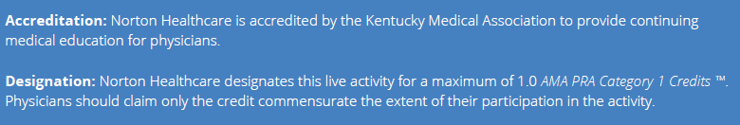

AMA PRA Category 1 Credits™

Slide 2
Nursing Credits
Norton Healthcare Institute for Education and Development is approved as a provider of nursing continuing professional development by the South Carolina Nurses Association, an accredited approver by the American Nurses Credentialing Center’s Commission on Accreditation. This continuing professional development activity has been approved for 1.0 contact hours. In order for nursing participants to obtain credits, they must claim attendance by attesting to the number of hours in attendance.
For more information related to nursing credits, contact Sally Sturgeon, DNP, RN, SANE-A, AFN-BC at (502) 446-5889 or sally.sturgeon@nortonhealthcare.org.

Slide 3
Planner Disclosure
The planner, Anupama Raghuram, M.D., discloses relevant financial relationships with ineligible companies Merck (stock) and Pfizer (stock, employee), These relationships have ended and the relationship has been successfully mitigated.
No other planners disclose relationships with ineligible companies.

Slide 4
Speaker Disclosure
The speaker, Lee Hundley, MPH, has no relevant financial relationships with ineligible companies to disclose.

Slide 5
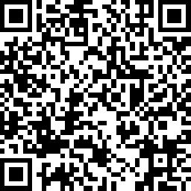
Evaluation & Attendance
Scan QR Code for evaluation and to claim credit.

