Slide 1
SKIN ANTISEPSIS IN THE PREVENTION OF SURGICAL SITE INFECTIONS (SSI)
Dr. Laurel A. Robinson DNP APRN FNP-C
APP Nurse Specialist
Norton Infectious Diseases Institute

Slide 2

Funding for this presentation provided by the Kentucky Department for Public Health.
Content includes discussion of unlabeled use of products. Presenter has no financial interests or other relationships with the manufacturers of products. No commercial support was provided for this educational activity.

Slide 3
Objectives
Discuss the significance of Surgical Site Infections (SSIs): Explain the impact of SSIs on patient outcomes, healthcare costs, and hospital resources.
Discuss the role of skin antisepsis in the surgical setting for the prevention of SSIs
Compare different skin antisepsis products and recommendations for use
Identify breaks in sterile technique that can lead to SSIs

Slide 4
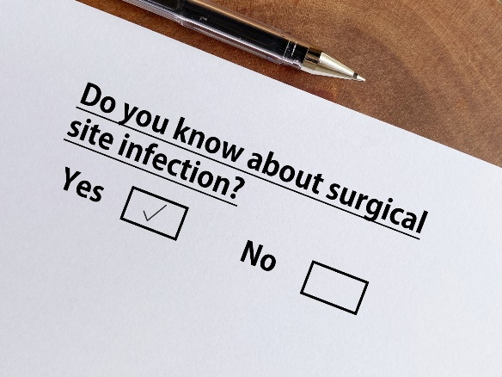
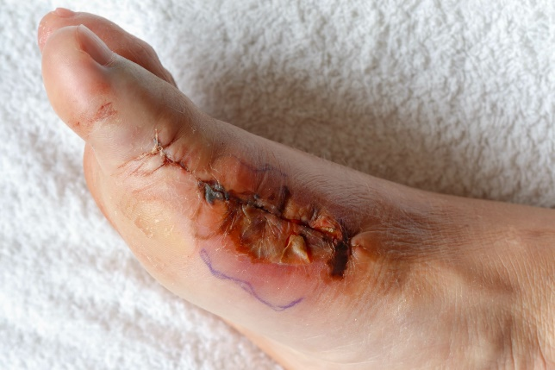
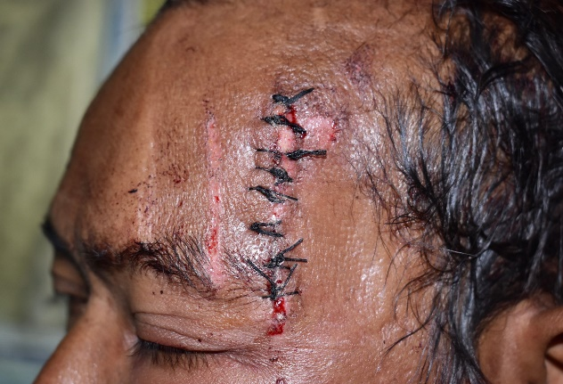
Surgical Site Infections (SSIs)
A surgical site infection is an infection that occurs after surgery in the part of the body where the surgery took place.
Surgical site infections can sometimes be superficial infections involving the skin only.
Other surgical site infections are more serious and can involve tissues under the skin, organs, or implanted material. (CDC, 2019)
Notes:
Define SSI per CDC definition
Many factors in a patient’s journey through surgery have been identified as contributing to the risk of SSI. The prevention of these infections is complex and requires the integration of a range of measures before, during and after surgery.
Some factors such as age, gender and co-morbidities that predispose one to a higher likelihood of SSIs cannot be controlled; however other factors, such as skin preparation using correct aseptic technique, are factors that we can control.

Slide 5

Surgical Site Infections (SSIs)
SSIs are associated with prolonged duration of hospitalization, readmissions, re-interventions, permanent disability or even death.
There is an increasing demand for evidence-based interventions for the prevention of SSIs.
Financial costs of treating SSIs are increasing.
Increasingly complex surgical patients and procedures.
It has been estimated that approximately half of SSIs are preventable by application of evidence-based strategies.
(CDC, 2019)
Notes:
SSIs are associated with prolonged duration of hospitalization, readmissions, re-interventions, permanent disability or even death

Slide 6
Preoperative skin antisepsis
The goal of preoperative patient skin antisepsis is to reduce the patient’s risk of developing an SSI by removing soil and transient microorganisms at the surgical site.
Reducing the amount of bacteria on the skin near the surgical incision lowers the risk of contaminating the surgical incision site.
Effective skin antiseptics rapidly and persistently remove transient microorganisms and reduce resident microorganisms to sub pathogenic levels with minimal skin and tissue irritation.
Notes:
Preoperative bathing. Patients should bathe at least once with soap or an antiseptic before surgery to reduce microbial flora on their skin, according to the guideline. The guideline acknowledges more research is needed to determine whether soap or an antiseptic is best to use, the optimal timing of the bathing before procedures, the number of times patients should bathe and whether they should clean their entire body or focus on the area around the planned surgical site.
The guideline says a standardized application method is best and patients should be provided with clear instructions on how to apply antiseptics to ensure maximal skin concentration — repeated application and pausing before rinsing allows CHG to bind to the skin, for example. Electronic reminders are effective ways to ensure patients comply with pre-op bathing requirements and the antiseptic manufacturer’s instructions for use.
Proper skin asepsis is essential to decrease the chance of developing a surgical site infection.
Please note that it is important not to shave the day before or day of surgery. If hair needs to be removed from the surgical site, the surgeon may chose to use clippers prior to the procedure.
Not all germs can be eliminated with the preoperative bath. Additional skin preparation occurs in the OR right before the draping and incision of the patient.
(AORN, 2023)

Slide 7

Preoperative Bathing
Follow these instructions the evening before and morning of surgery:
Do not shave the day before or day of surgery.
Remove all jewelry until after surgery. Take off rings and take out all body-piercing jewelry.
Use a clean wash cloth and towel.
Wash your face and hair with your normal soap and shampoo before you use the CHG soap.
Use a wash cloth to clean your skin with the CHG soap. Use enough CHG soap to cover the skin on your whole body. Use the same amount as you would with your normal soap.
Do not use the CHG soap on your face, eyes, ears, or head.
Do not scrub your skin too hard.
Be sure to clean the area well where surgery will be done.
Do not wash with your normal soap after the CHG soap.
Keep away from the water stream when you put CHG soap on. This keeps it from rinsing off too soon.
Rinse your body well.
Pat yourself dry with a clean, soft towel.
Put on clean clothing.
Do not put on any deodorants, lotions, or oils after showering. These might block how the CHG soap works.
Notes:
Preoperative bathing. Patients should bathe at least once with soap or an antiseptic before surgery to reduce microbial flora on their skin, according to the guideline. The guideline acknowledges more research is needed to determine whether soap or an antiseptic is best to use, the optimal timing of the bathing before procedures, the number of times patients should bathe and whether they should clean their entire body or focus on the area around the planned surgical site.
The guideline says a standardized application method is best and patients should be provided with clear instructions on how to apply antiseptics to ensure maximal skin concentration — repeated application and pausing before rinsing allows CHG to bind to the skin, for example. Electronic reminders are effective ways to ensure patients comply with pre-op bathing requirements and the antiseptic manufacturer’s instructions for use.
Proper skin asepsis is essential to decrease the chance of developing a surgical site infection.
Please note that it is important not to shave the day before or day of surgery. If hair needs to be removed from the surgical site, the surgeon may chose to use clippers prior to the procedure.
Not all germs can be eliminated with the preoperative bath. Additional skin preparation occurs in the OR right before the draping and incision of the patient.
(AORN, 2023)

Slide 8
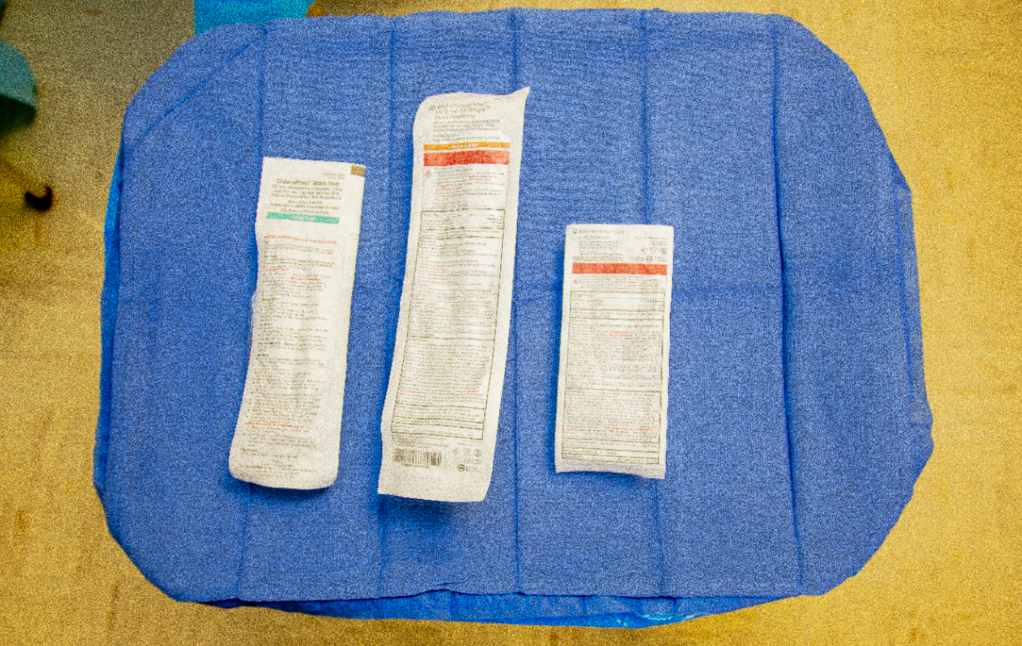
Alcohol-Based Antiseptic Solutions
Alcohol-Based Antiseptics
Alcohol-based antiseptics are considered superior in terms of clinical and antimicrobial effectiveness than other no-alcohol antiseptics.
If an alcohol-based prep is used, it is imperative that you include it in your fire risk assessment calculation and follow the IFU for the dry time (eg, three minutes on hairless skin and up to one hour for hair).
Chlorhexidine
Notes:
Antiseptic application. Prep selection is a complex process based on knowledge of current research, clinical guidelines and information provided by prep manufacturers — as well as feedback from frontline staff about how the products are used in practice.
Facilities should rely on their interdisciplinary committee to identify and standardize the prepping agents used for procedure types based on clinical research about the efficacy of each agent against the bacteria at specific surgical sites.
One of the more significant updates in the AORN guideline is the recommended use of an alcohol-based antiseptic unless it is contraindicated. Alcohol has a broad spectrum of effective bactericidal activity, but it lacks persistence. Combining it with another agent such as CHG or povidone-iodine provides a rapid, persistent and cumulative effect, notes the guideline.
AORN recommends selecting an alcohol-based prepping agent based on the patient assessment and anatomical location of the surgical site. The guideline suggests assessing the surgical site for skin integrity, the presence of hair and proximity to mucosa, eyes or ears. Alcohol-based preps should not be used on the mucosa or eyes, and studies have found that iodine-based, non-alcoholic products are safest for use in the ear when applied with caution.

Slide 9
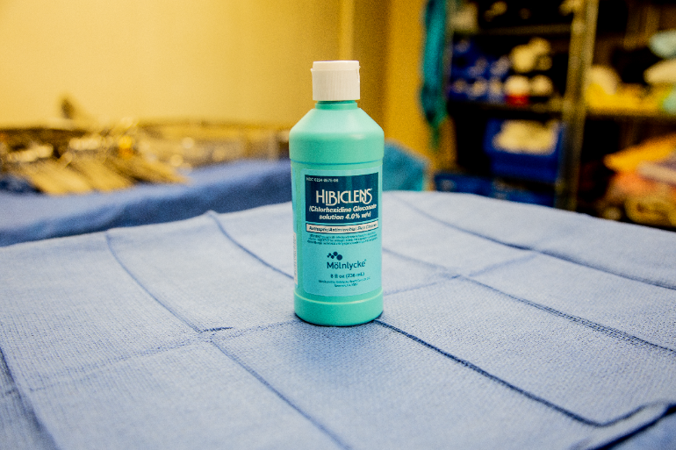
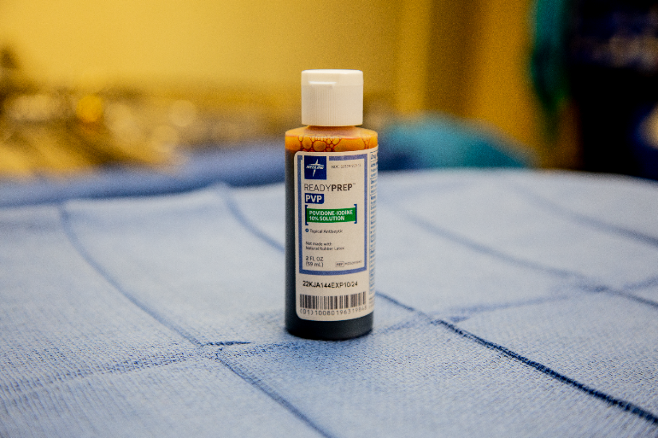
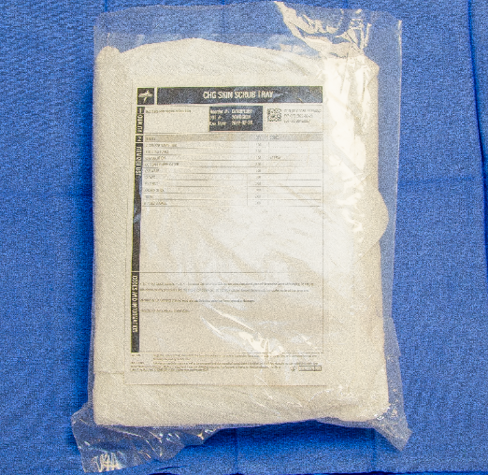
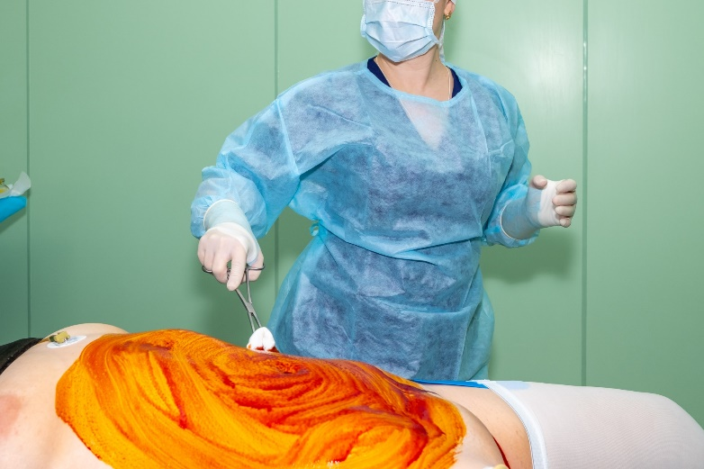
Alternatives to Alcohol Based Skin Antiseptic solutions
Notes:
Things to consider when choosing skin antiseptic solutions:
(CHG is recommended.)
Site of surgical incision
Proximity to eyes, ears, and mucosa
Skin integrity
Skin tone to ensure the prep solution is visible
Allergies and sensitivities, such as susceptibility to iodism
Patient age, such as neonates who have increased sensitivity to skin agents
Amount and thickness of hair near surgical site and area where drapes will be placed

Slide 10
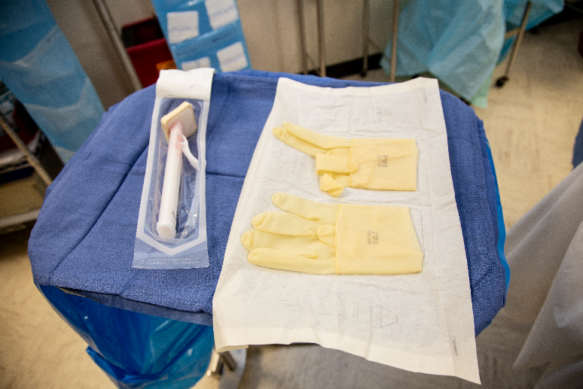
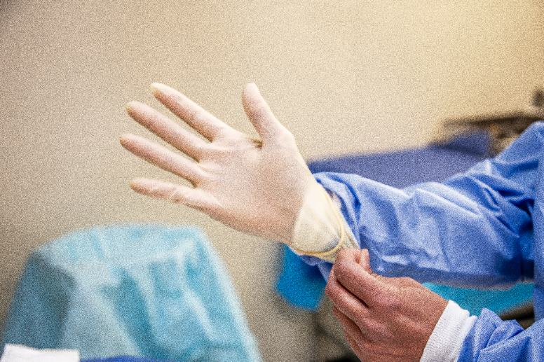
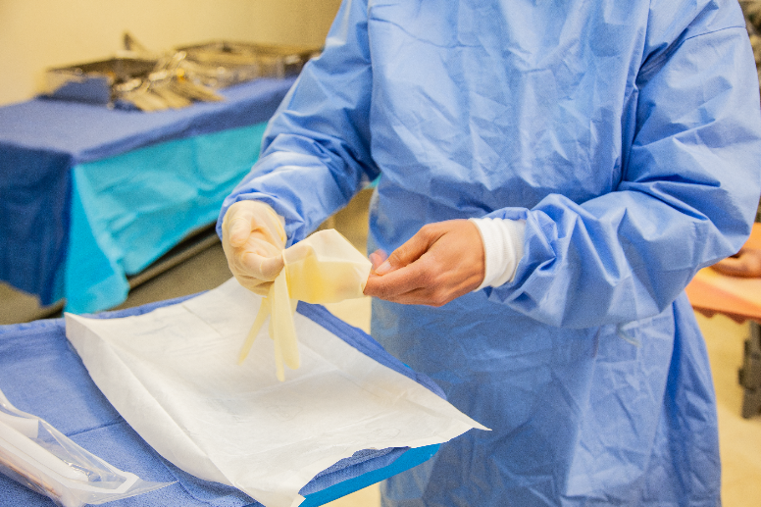
Perform hand hygiene, and prepare the area for donning your sterile gloves on a stand or table above waist level.
Open your sterile glove packaging and prep solution, BEFORE donning your sterile gloves*.
It is not necessary to wear a sterile gown unless required by your facility.
* If you are using an applicator that is long enough to avoid contact with the gloved hand, antiseptic, and patient’s skin, you can don nonsterile gloves. If there is a potential risk for contamination, you should don
sterile gloves (AORN, 2023).
Notes:
Read from page

Slide 11
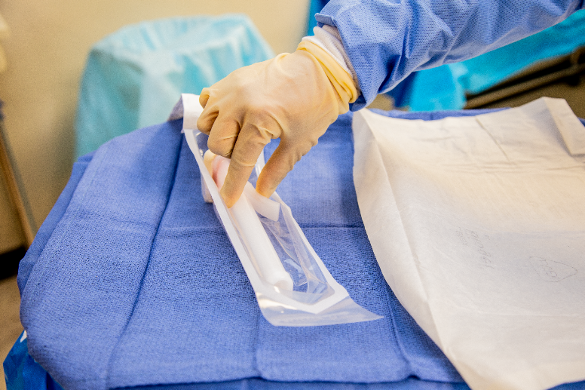
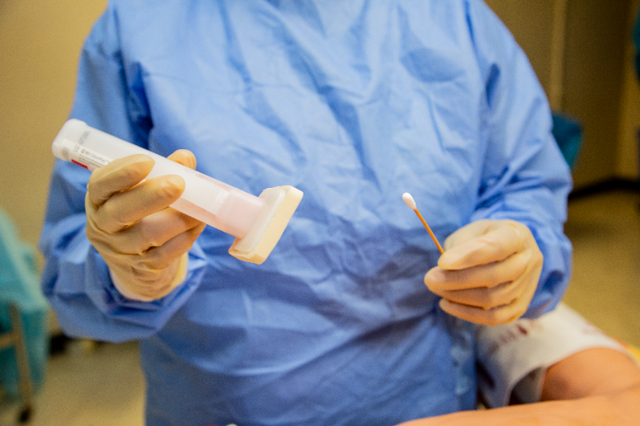
Be careful to not contaminate
your gloves when reaching in
to get the prep stick.
If there is a cotton applicator
in the package, remove that as
well.

Slide 12
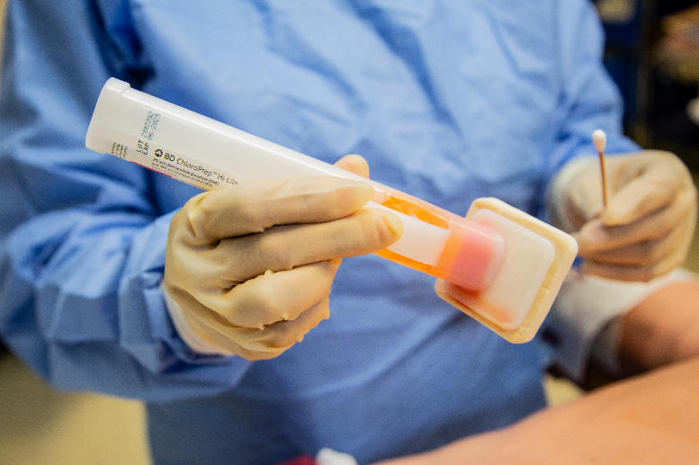
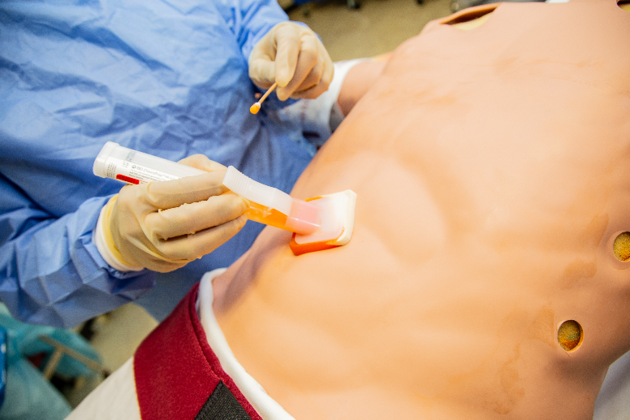
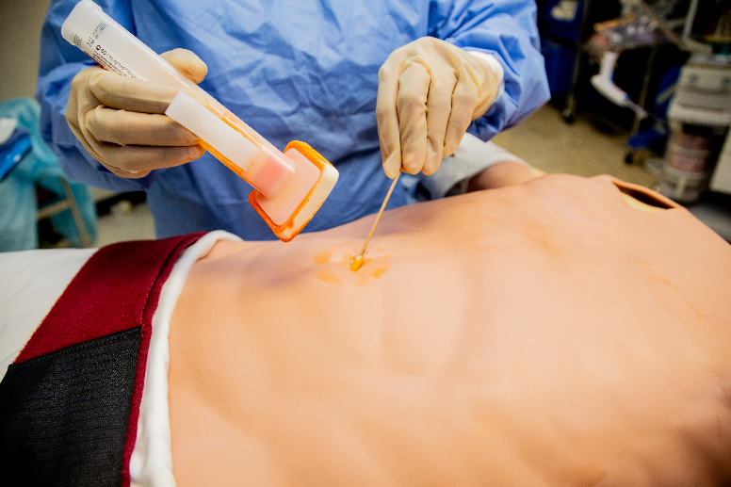
Hold the applicator with the sponge down. Do not touch the sponge.
Pinch the wings only once to activate the ampule and release the antiseptic.
Pre-clean umbilicus removing any debris with a cotton applicator soaked in the prep solution.
Notes:
Read from slide

Slide 13
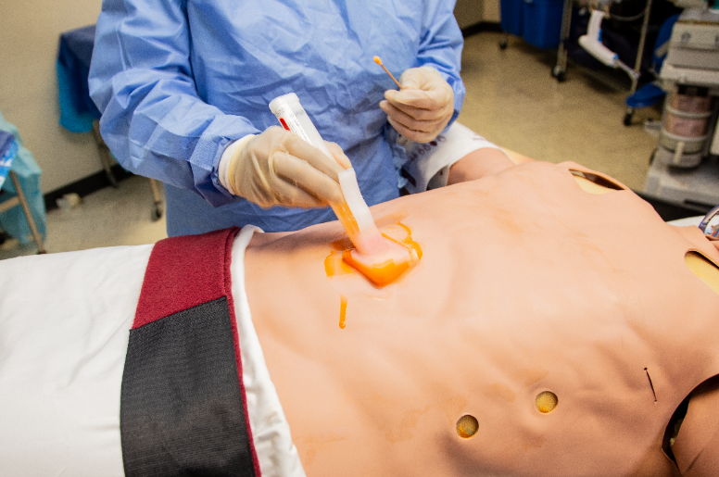
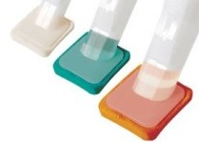
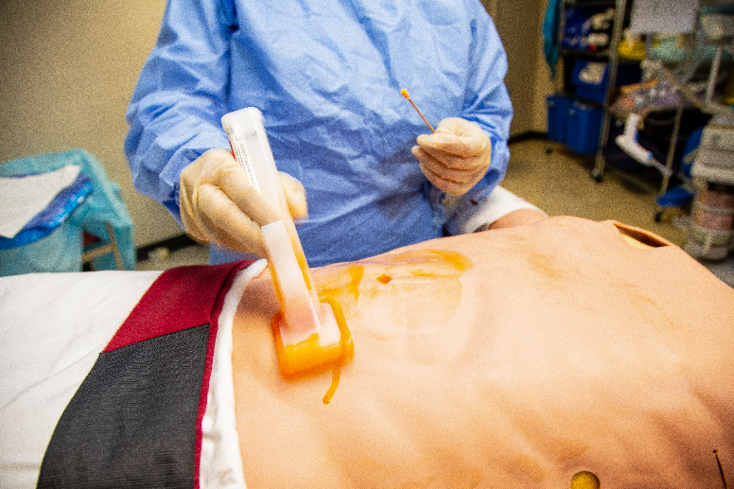
Prepping with 2% CHG with Alcohol
The CHG prep comes in two different tints: orange and teal. The orange tint is more visible on fair skin tones whereas the teal tint is more visible on medium to dark skin pigmentation.
To prep with 2% CHG with alcohol:
Use the prefilled applicator to apply the solution, starting at the incision site using gentle back-and-forth strokes following the manufacturer’s IFU (eg, 30 seconds) and then proceed to the periphery (ie, clean to dirty).
Notes:
Read from slide

Slide 14
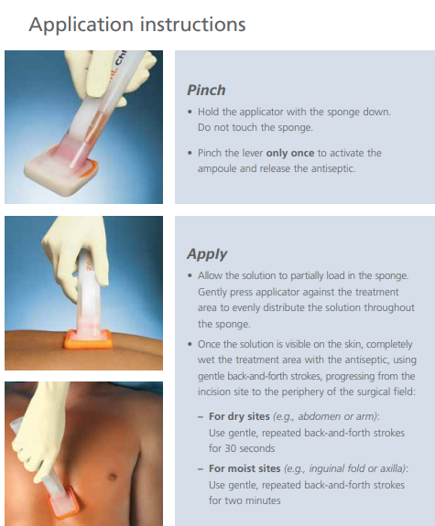
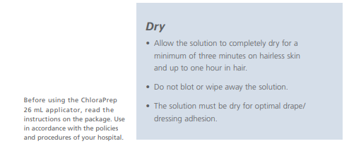
Notes:
(see notes)

Slide 15
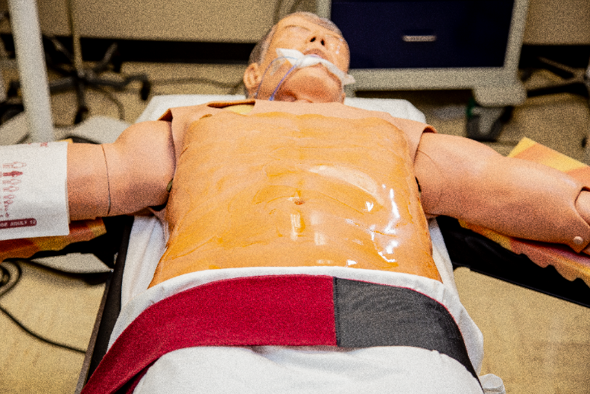
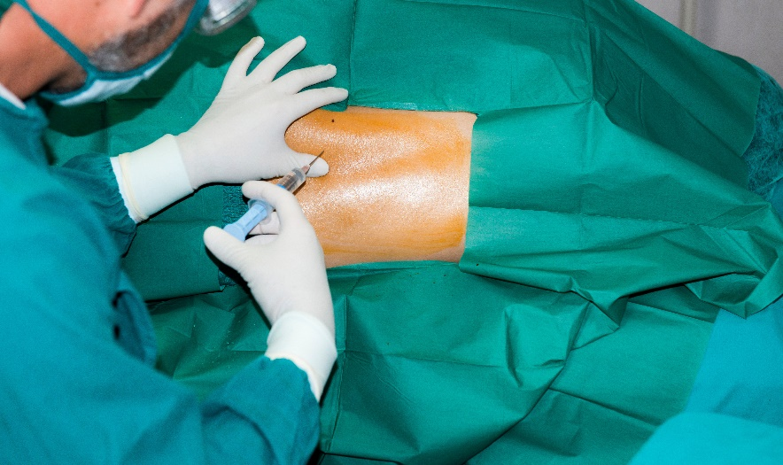
Don’t forget the prep drying time!
Notes:
After the patient is prepped, the prep must dry the allotted time for maximum antimicrobial effect, and to reduce fire risk.
This is normally 3 minutes for hairless skin, or up to an HOUR if prepped within hair.
The patient is then draped by the sterile surgical team with sterile drapes, to prepare for a surgical incision.

Slide 16

Improper Skin Antisepsis
Notes:
(see notes for intro to video)

Slide 17
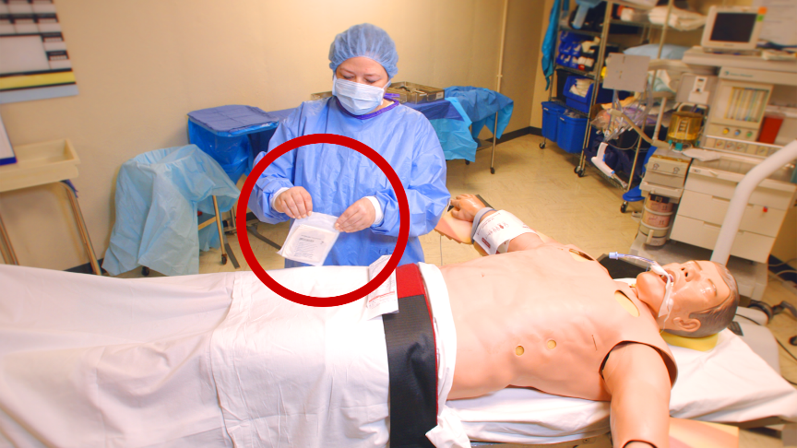
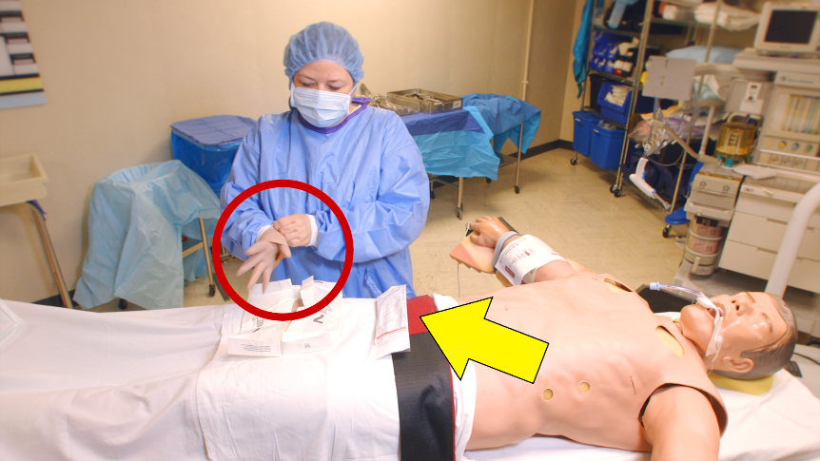
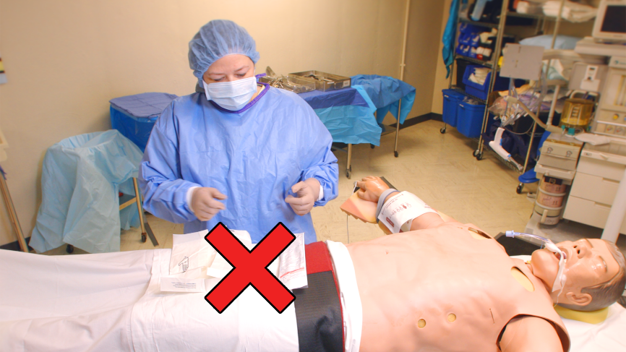
Improper Sterile Technique Examples
No hand hygiene performed
Setting up sterile field on patient
Sterile glove packaging closed over sterile gloves before donning
Do you see any other breaks in sterility?
Notes:
Now that we have viewed the video, I would like you to recall some scenes that show examples of improper sterile technique, when performing a skin prep.

Slide 18
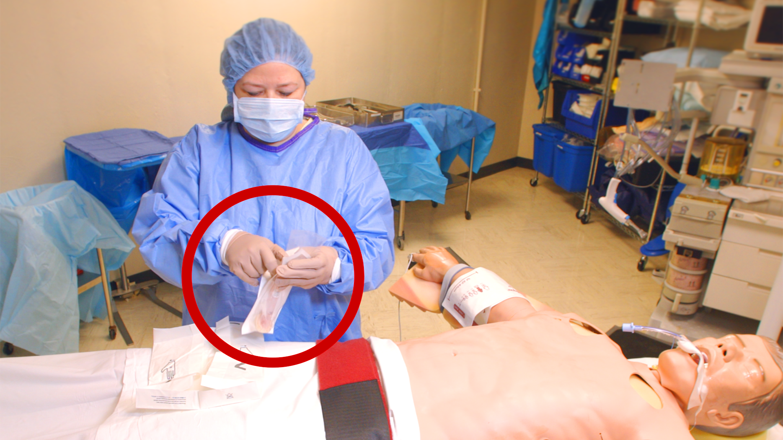
What is wrong here?
Prepare your sterile field and open sterile items ahead of time.
Opening the prep packaging AFTER donning sterile gloves, is a break in sterility that could lead to an SSI.
Notes:
(see notes)

Slide 19
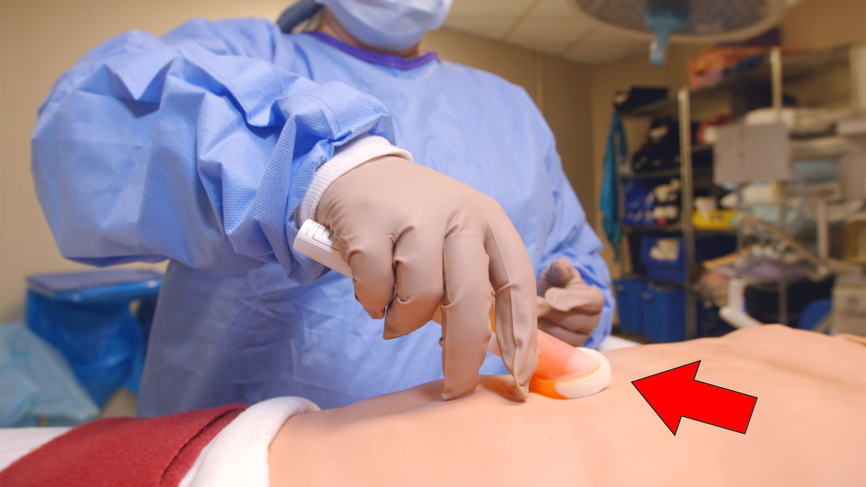
Can you spot the error?
This prep applicator is too small for an adult size patient’s abdomen.
Using the correct amount of surgical prep solution ensures coverage of the surgical site and optimizes the chances of not developing an SSI.
See the manufacturer’s guidelines for the recommended size prep applicator/prep amount for the surface area of skin needing to be covered.
Notes:
(see notes)

Slide 20
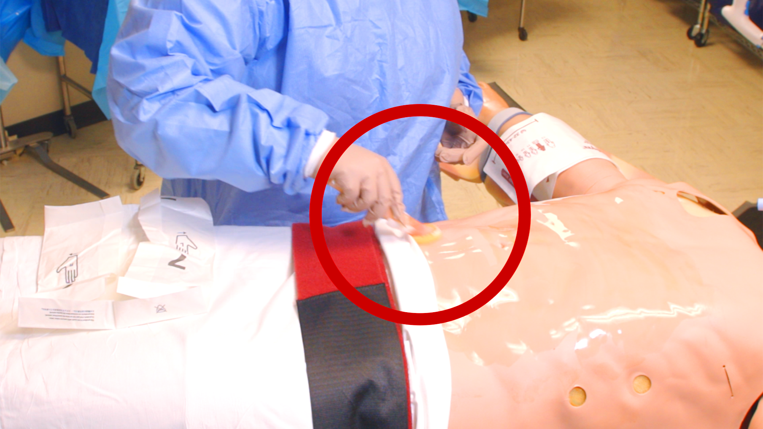
Where is the break in sterility?
The prep sponge has come in contact with the non-sterile patient blanket, and is now contaminated.
Notes:
(see notes)

Slide 21
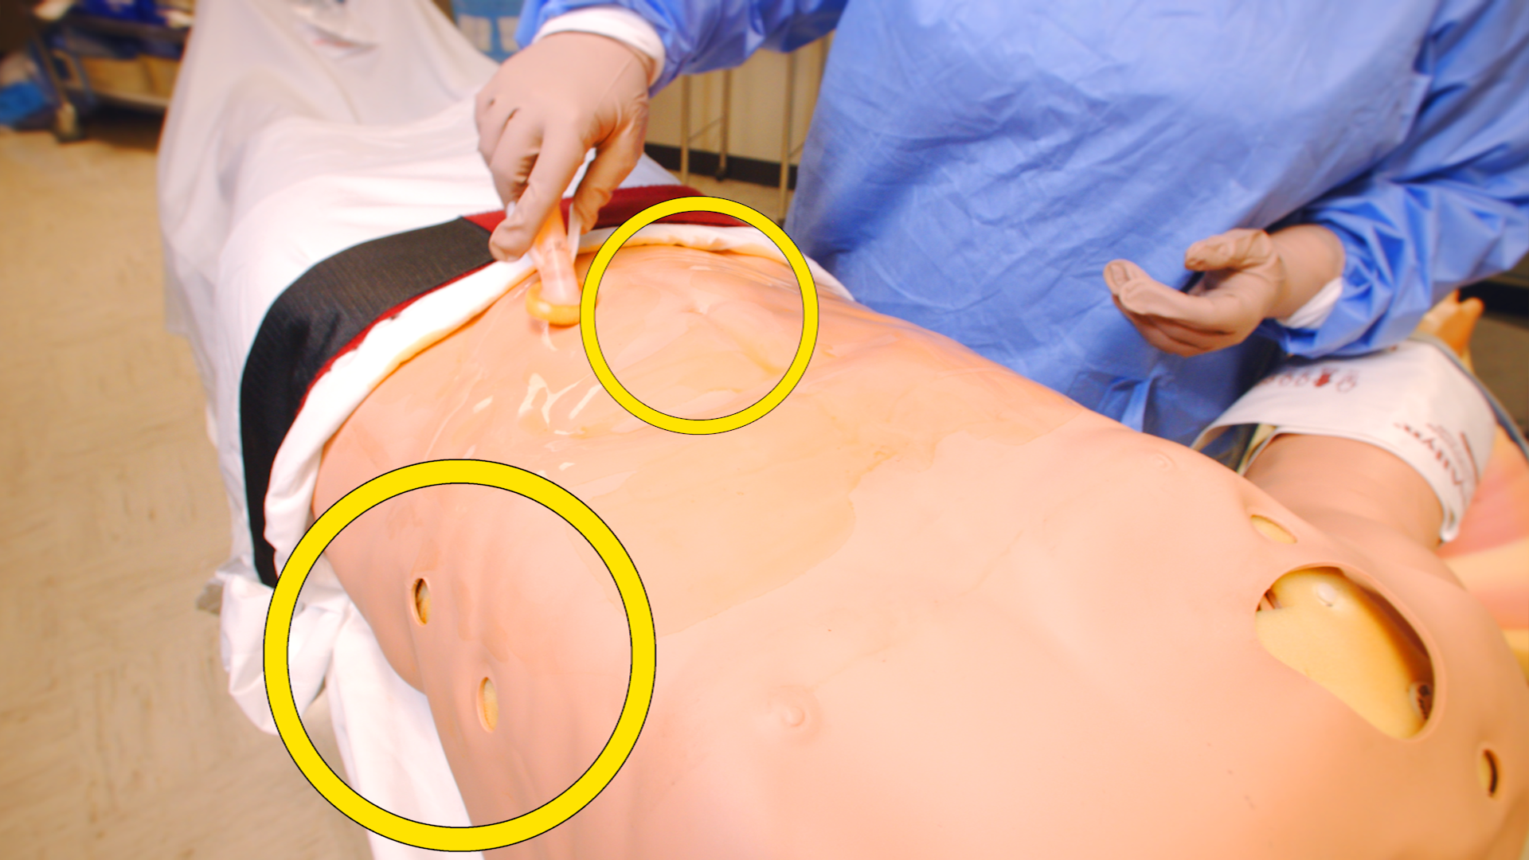
You missed a spot!
Inadequate coverage with the CHG prep solution can lead to contamination and surgical site infections.
CHG prep sticks come in different sizes, depending on this surface area to be covered.
Follow the manufacturer’s directions to make sure that all exposed skin in the operative site is covered with the antisepsis prep solution, and that the proper dry time has occurred for the maximum antisepsis protection.
Notes:
Read from slide

Slide 22
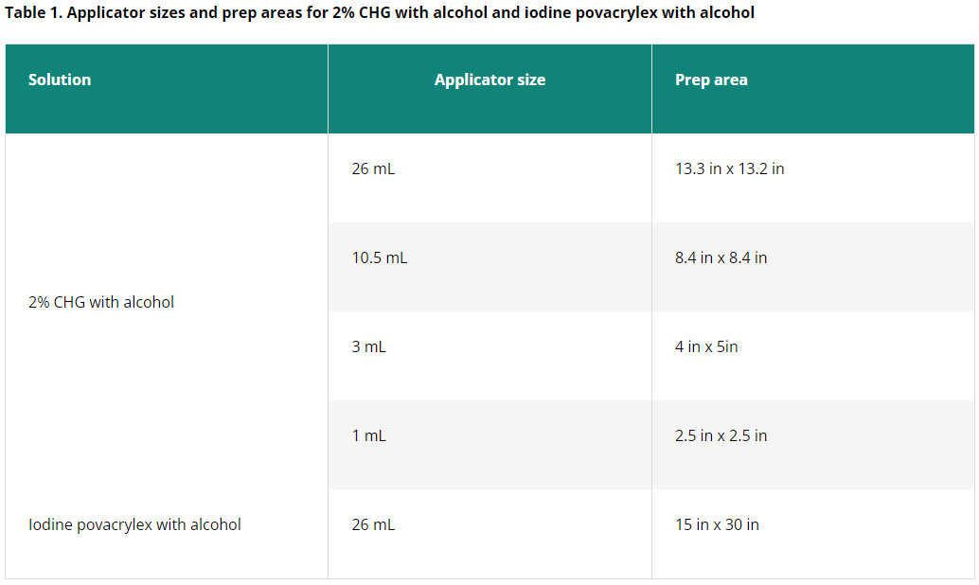
(AORN, 2020)

Slide 23
Take home points
SSIs can lead to increased length of postoperative hospital stay, drastically escalated expense, higher rates of hospital readmission, and jeopardized health outcomes.
Skin antisepsis is a critical component of surgical site infection (SSI) prevention. The primary source of organisms contributing to infection following surgery is the bacteria on a patient’s skin.
AORN recommends the use of chlorhexidine gluconate (CHG) as the preferred antiseptic agent for preoperative skin preparation. CHG has been shown to be more effective than other antiseptic agents in reducing the incidence of SSIs.
Surgical site infections can have multiple causes. Maintaining sterility during the pre-operative skin prep, is just one part of the process. It is important to utilize other forms of infection control including proper nutrition, wound care, and complete any course of antibiotics prescribed in order to adequately decrease the chance of developing a SSI.
Notes:
So to recap our objectives:
Discuss the significance of Surgical Site Infections (SSIs): SSIs can lead to increased length of postoperative hospital stay, drastically escalated expense, higher rates of hospital readmission, and jeopardized health outcomes.
Discuss the role of skin antisepsis in the surgical setting for the prevention of SSIsSkin antisepsis is a critical component of surgical site infection (SSI) prevention. The primary source of organisms contributing to infection following surgery is the bacteria on a patient’s skin.
Compare different skin antisepsis products and recommendations for use AORN recommends the use of chlorhexidine gluconate (CHG) as the preferred antiseptic agent for preoperative skin preparation. CHG has been shown to be more effective than other antiseptic agents in reducing the incidence of SSIs.
Identify breaks in sterile technique that can lead to SSIs Surgical site infections can have multiple causes. Maintaining sterility during the pre-operative skin prep, is just one part of the process. It is important to utilize other forms of infection control including proper nutrition, wound care, and complete any course of antibiotics prescribed in order to adequately decrease the chance of developing a SSI.

Slide 24
References:
AORN (2020, May 13). Patient Skin Antisepsis. AORN Guidelines. Retrieved September 15, 2023, from https://aornguidelines.org/guidelines/content?sectionid=245924616&view=book
BD ChloraPrep Preoperative antiseptic skin preparation with sterile solution. Accessed May 25, 2023. https://www.bd.com/en-ca/offerings/capabilities/infection-prevention/skin-preparation/bd-chloraprep-patient-preoperative-skin-preparation-products/bd-chloraprep-applicators.
Berríos-Torres SI, Umscheid CA, Bratzler DW, et al. Centers for Disease Control and Prevention Guideline for the Prevention of Surgical Site Infection, 2017. JAMA Surg. 2017;152(8):784–791. doi:10.1001/jamasurg.2017.0904
Global Guidelines for the Prevention of Surgical Site Infection. (2018). World Health Organization
Umscheid CA, Mitchell MD, Doshi JA, Agarwal R, Williams K, Brennan PJ. Estimating the proportion of healthcare-associated infections that are reasonably preventable and the related mortality and costs. Infect Control Hosp Epidemiol. 2011;32(2):101–114. 10.1086/657912
Zucco, R., Lavano, F., Nobile, C. G. A., Papadopoli, R., & Bianco, A. (2019). Adherence to evidence-based recommendations for surgical site infection prevention: Results among Italian surgical ward nurses. PloS one, 14(9), e0222825. https://doi.org/10.1371/journal.pone.0222825

Slide 25

KentuckyIPTraining.org

