Slide 1

Cleaning and Disinfection of Reusable Medical Equipment
LAUREL ROBINSON DNP APRN FNP-C
Ruth Carrico phd dnp aprn cic fshea fnap faan

Slide 2
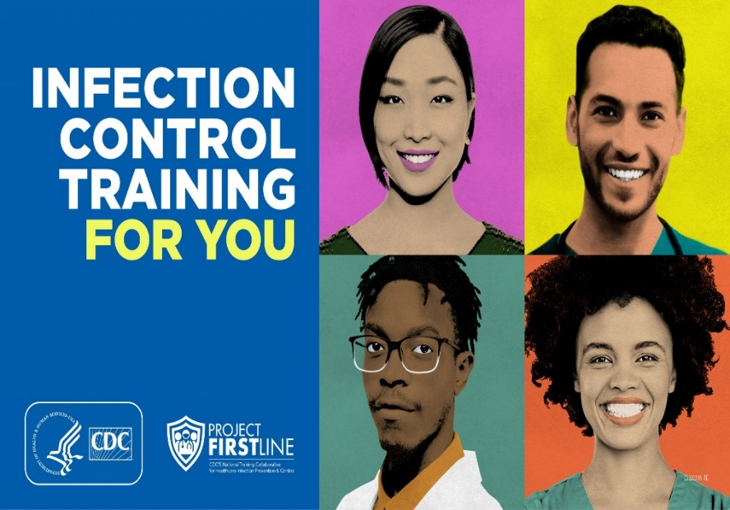
PROJECT FIRSTLINE
Project Firstline is a national collaborative led by the U.S. Centers for Disease Control and Prevention (CDC) to provide infection control training and education to frontline healthcare workers and public health personnel. The Kentucky Infection Prevention Training Center is proud to partner with the Kentucky Department of Public Health and Project Firstline. Funding for the Kentucky Infection Prevention Training Center (KyIP) is provided through the Centers for Disease Control and Prevention (CDC) Epidemiology and Laboratory Capacity (ELC) Enhancing Detection grant supplement award to the Kentucky Department for Public Health (KDPH). CDC is an agency within the Department of Health and Human Services (HHS). The contents of this simulation skill packets do not necessarily represent the policies of CDC or HHS and should not be considered an endorsement by the Federal Government
Notes:
Project Firstline is a national collaborative led by the U.S. Centers for Disease Control and Prevention (CDC) to provide infection control training and education to frontline healthcare workers and public health personnel. The Kentucky Infection Prevention Training Center is proud to partner with the Kentucky Department of Public Health and Project Firstline. Funding for the Kentucky Infection Prevention Training Center (KyIP) is provided through the Centers for Disease Control and Prevention (CDC) Epidemiology and Laboratory Capacity (ELC) Enhancing Detection grant supplement award to the Kentucky Department for Public Health (KDPH). CDC is an agency within the Department of Health and Human Services (HHS). The contents of this simulation skill packets do not necessarily represent the policies of CDC or HHS and should not be considered an endorsement by the Federal Government

Slide 3
objectives
AT THE END OF THESE SKILL STATIONS, PARTICIPANTS WILL BE ABLE TO:
Define the role of reusable medical equipment in pathogen (germ) transmission
Review types of low-level and intermediate-level disinfectants used in healthcare settings
Describe the Spaulding Classification as a guide for use of disinfection approaches relevant to reusable medical equipment
Apply knowledge in practice to minimize risk associated with pathogen (germ) transmission and reusable medical equipment
Notes:
At the end of this session, participants will be able to:
1. Define the role reusable medical equipment may have in pathogen transmission
2. Review types of low-and intermediate -level disinfectants used in healthcare settings
3. Describe the Spaulding Classification as a guide for use of cleaning and disinfection approaches relevant to reusable medical equipment
4. Apply knowledge in practice to minimize risk associated with pathogen transmission and reusable medical equipment
As we move though these objectives, we will structure the information into three sections. First, we will provide basic information that establishes background concepts important when outlining the ‘why’ behind the content. This is the Pre-Brief section. The second section will contain simulation examples. These examples seek to demonstrate application of the content and visually demonstrate the reason it is important for healthcare workers to understand the rationale, or the ‘why’, behind infection prevention measures. The last section is the De-Brief. During this last section, participants are guided through discussions that dive deeper into the knowledge application challenges and barriers and help participants take steps enabling them to put knowledge into action that is scalable and transferrable to various situations and care settings.

Slide 4
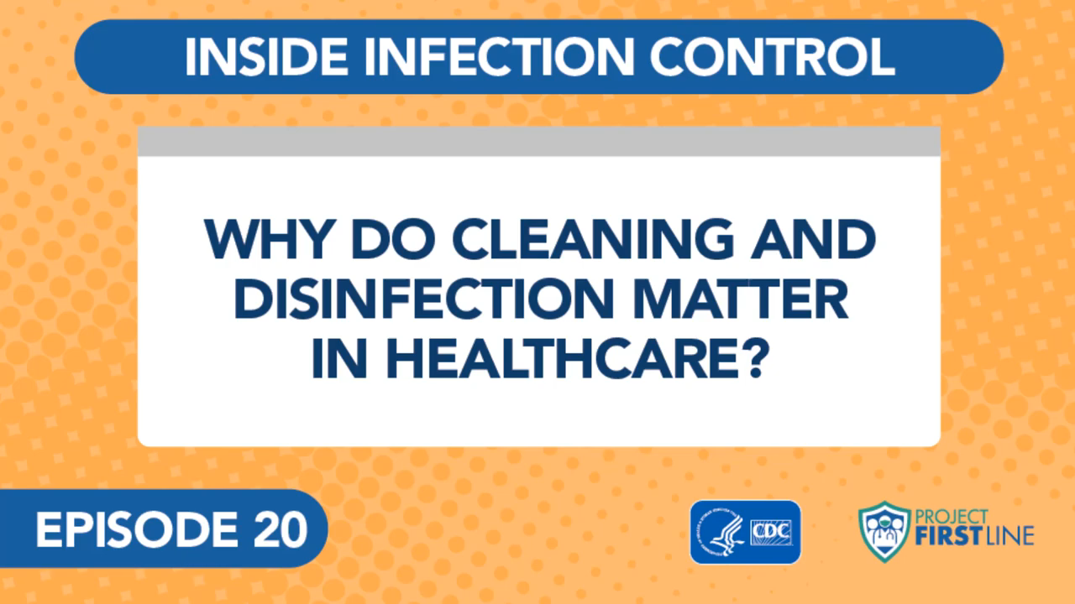
Pre-Brief: Dr. Abby Carlson, MD
(CDC, 2021)
Notes:
To set the stage for this discussion, let’s listen to some information provided by Dr. Abby Carlson describing why cleaning and disinfection matter in healthcare.

Slide 5
WHAT IS REUSABLE MEDICAL EQUIPMENT?
Patient care in almost every setting involves the use of equipment that is not disposable or single use.
Examples include blood pressure machines, glucose meters, thermometers, infusion pumps, and patient furniture.
Some reusable medical equipment is used for more specialized purposes including laryngoscope blades, ultrasound probes, and surgical instruments.
This shows that not all pieces of medical equipment are used for the same purpose and not all are cleaned and disinfected in the same way.
CDC, 2008. Guidelines for Disinfection and Sterilization in Healthcare Facilities; US Department of Labor, 1992. Bloodborne Pathogens Standard
Notes:
When care is provided healthcare workers use a variety of supplies and equipment. Some items are disposable such as dressing supplies, personal hygiene items, injection supplies, pop-up disinfectant wipes, and some pieces of personal protective equipment. Those items are used once, then disposed. However, many items used in healthcare are not disposable. They are needed to be used on multiple patients, and sometimes items are moved quickly from patient to patient. Dr. Carlson just talked about these situations and the risks associated with those devices. The reality is that patient care in almost every setting involves the use of equipment that is not disposable or designed to be used only once with a single patient. Examples of items that are reused include blood pressure machines, glucose meters, electronic thermometers, infusion pumps, and patient furniture. Each of those pieces of reusable equipment have a different use and may have different ways of being disinfected. Nevertheless, it is important that each healthcare worker recognize that anything that is used as part of the care, or contact with a patient, must be cleaned and disinfected before being used on another.

Slide 6
WHAT IS CLEANING AND WHY IS IT IMPORTANT?
Cleaning is removal of visible soil (e.g., organic and inorganic material) from objects and surfaces and normally is accomplished manually or mechanically using water with detergents or enzymatic products.
Thorough cleaning is essential before disinfection because inorganic and organic materials (e.g., blood or other body fluid) that remain on the surfaces of instruments interfere with the effectiveness of these processes.
Removal of visible soil should be done prior to disinfection.
CDC, 2008. Guidelines for Disinfection and Sterilization in Healthcare Facilities; US Department of Labor, 1992. Bloodborne Pathogens Standard
Notes:
Let’s start by reviewing some terms. Cleaning is the removal of visible soil. This includes organic material such as body fluid, as well as inorganic matter such as dust. All objects and surfaces in healthcare settings must be regularly cleaned to remove these materials. Cleaning is accomplished either manually by an individual wiping the surface or items, or it can be done mechanically. Examples of mechanical cleaning include automatic floor scrubbers used by environmental services workers and instrument washers used in instrument decontamination areas. Cleaning is done using detergents mixed with water, or enzymatic products also mixed with water. Detergents often have an agent that helps suspend organic and inorganic material so they can be wiped away. Enzymatic products help begin a process that dissolves the material so it can also be wiped away.
It is important that cleaning of every item be done prior to disinfection because material left on the surfaces of reusable items may minimize the effectiveness of the disinfectant products. So, the point to remember is that removal of organic or inorganic material should always be done before disinfection.

Slide 7
WHAT IS DISINFECTION AND WHY IS IT IMPORTANT?
Disinfection is a process that eliminates many germs, but not all bacterial spores, on inanimate objects.
In health-care settings, objects are commonly disinfected through the use of liquid chemicals commonly called germicides.
The Environmental Protection Agency (EPA) regulates germicides and uses information from the manufacturer to determine what is on the product label. The EPA website has a full list of germicides for use in healthcare.
During the COVID-19 pandemic, we learned about List N, the EPA list of germicides demonstrating effectiveness against emerging pathogens.
Rutala, 2016. Disinfection and Sterilization in Health Care Facilities; EPA, 2020. Disinfectants for COVID-19
Notes:
Once the item has been cleaned, it is then important to eliminate GERMS that may be on that item or surface. Disinfection is a process that eliminates many GERMS capable of causing illness, but not all of them. Disinfectants, also called GERMICIDES, are chemicals able to kill many of those germs. Bacterial spores are microorganisms that are more difficult to kill and require special types of germicides, or even sterilization, to kill them. The Environmental Protection Agency (EPA) is the United States government agency that regulates germicides and uses information from germicide manufacturers to determine what is on the product labels. In healthcare, we use germicides able to kill the germs commonly seen in healthcare settings. These are often different from the germs we have in our homes. Therefore, the germicides used in healthcare are of a higher grade than those used in non-healthcare settings. The EPA maintains lists of germicides suitable for use in healthcare settings, and these are often called ‘healthcare grade’ or ‘hospital-approved’ germicides. They are not restricted for use in hospitals, but are appropriate for use in all healthcare settings. During the COVID-19 pandemic, the EPA provided an updated list of germicides effective against emerging germs. This list is called ‘List N’ and can be found on the EPA website along with all EPA-registered disinfectants suitable for use in healthcare settings.

Slide 8
WHAT ARE SOME BASIC ACTIVITIES IMPORTANT WHEN CLEANING AND DISINFECTING REUSABLE EQUIPMENT?
Written policies and procedures that also incorporate manufacturer instructions for use of the disinfectant
Training of healthcare personnel so they are familiar with the equipment to be disinfected and the germicide being used
Use of appropriate disinfectant, appropriate dilution, appropriate application methods
Cleaning before disinfection
Contact time of the disinfectant
Safe use, including personal protective equipment
Notes:
When approaching a process for cleaning and disinfection of reusable medical equipment, it is important to have guiding documents that can be used for training and for evaluating practices and processes. Written policies and procedures should include information about the germicide and instructions for use. This information is available from the germicide manufacturer. Using policies and procedures that include ‘how to use’, and ‘when to use’, help train healthcare personnel so they are familiar with the germicide being used and how to use it on particular reusable items. Those using disinfectants should be aware of the appropriate product, how to dilute or mix it, and how to apply it to the surface of the item. Individuals responsible for cleaning and disinfecting reusable items must be aware of the need to clean before disinfecting, then use the right disinfectant and let is sit undisturbed for the contact time noted on the product label. In addition, proper personal protective equipment, such as gloves, should be worn when applying the disinfectant to the item. If germicides are mixed, the addition of water to the disinfectant concentrate may result in a splash so the individual mixing the germicide should be prepared to don eye protection during that process. Some disinfectants may be applied using a spraying device. Some of those devices may require additional protective equipment including respiratory protection.

Slide 9
HOW DO WE KNOW HOW TO SELECT AND USE APPROPRIATE DISINFECTION PRACTICES?
Written policies and procedures that also incorporate manufacturer instructions for use of the disinfectant
Training of healthcare personnel so they are familiar with the equipment to be disinfected and the germicide being used
Use of appropriate disinfectant, appropriate dilution, appropriate application methods
Cleaning before disinfection
Contact time of the disinfectant
Safe use, including personal protective equipment
Notes:
Once we know the basics, how do we apply this knowledge regarding selection and use of the appropriate disinfectant and disinfectant practices? First, we need to have written policies and procedures that outline when to use particular germicides and how to use them. To ensure that everyone is trained consistently, this should be clearly outlined, then those policies and procedures aligned with performance monitoring.
For example, if a germicide requires a contact time of 3 minutes, how can the person performing disinfection know that? Do they understand that the three minute contact time allows the germicide to work, undisturbed. If the germicide is applied, then the surface is wiped again disturbing that germicide, then the disinfecting effect may be reduced. This is why it is important that those disinfecting equipment be aware of the importance of their job.
If pop-up wipes are used, they must be wet so they are able to transfer that wet germicide to the surface of the item being disinfected. Therefore, training and policy should include specific information regarding the importance of keeping containers closed so evaporation is prevented.
It is important to understand the basics so the person performing equipment disinfectant knows why their work is important and why it is important to follow the steps outlined in policies. It is critical that individuals developing policies and procedures have specific knowledge of germicides and how they work.

Slide 10
SPAULDING CLASSIFICATION
Level of Risk to Patient | Definition | Descriptive Application | Examples | Disinfection Method
Non-Critical | Device only contacts intact, healthy skin | Items that do not make contact with the patient or, if they do, only with intact skin. | · Stethoscope · Scanning thermometer · Scanning ultrasound probe · Glucose meter (not the lancing device that pierces the skin and is disposable) · Blood pressure cuff · Patient furniture | Low-Level Disinfection (LLD) using an intermediate-level disinfectant (ILD) products
Spaulding, 1968. Chemical Disinfection of Medical and Surgical Materials
Notes:
We have talked about germicides and that they may differ, so let’s now talk about the framework that guides decision-making when we are developing procedures to clean and disinfect reusable medical equipment that may have different purposes for patient are. The framework that is accepted and supported by the Centers for Disease Control and Prevention, the CDC, and the Environmental Protection Agency, the EPA, is the Spaulding Classification. This classification outlines the type of equipment and its reason for use, then determines the risk that the device presents to the patient. The cleaning and disinfection methods are determined by the risk posed by the piece of reusable medical equipment and its intended use.
For example, let’s talk about the lowest level of risk. First, remember that there is never a situation where NO RISK is present. That is why we always clean and disinfect items that will come into contact with a patient or be touched by a healthcare worker who then touches a patient. Remember the way germs can be transferred from equipment to patients, so proper cleaning and disinfection helps prevent that transfer opportunity. According to Spaulding, there are three levels of patient risk involved in medical devices and equipment. Non-Critical risk involves devices or equipment that only come into contact with healthy skin of the patient. Examples include stethoscopes, electronic thermometers, blood pressure cuffs, patient furniture, ultrasound probes used for scanning, and glucose meters. It is important to note that when cleaning and disinfecting glucose meters, we are focused on the actual device that reads the test strip and not the lancing device used to pierce the skin. Those lancing devices are single patient use and should never be shared. The Lancet, or finger sticking device, is single use and disposed of after each skin pierce. This is an example as to why it is vital to know the device and the why behind its use and its risk to the patient. This knowledge drives correct decision-making. For those non-critical items, a hospital grade low- level disinfectant or intermediate-level disinfectant product should be used.

Slide 11
SPAULDING CLASSIFICATION
Level of Risk to Patient | Definition | Descriptive Application | Examples | Disinfection Method
Semi-Critical | Device contacts mucous membranes or non-intact skin | Items making direct contact with mucous membranes, but the tissues are intact and therefore constitute barriers to infection. | · Laryngoscope blade · Flexible endoscope · Endovaginal ultrasound probe | High-Level Disinfection (HLD)
Spaulding, 1968. Chemical Disinfection of Medical and Surgical Materials
Notes:
Some devices will make direct contact with mucous membranes such as the throat or vaginal canal. Examples include laryngoscope blades and various types of scopes. These devices represented a greater patient risk and must be cleaned and disinfected to a higher level. This level of risk is called semi-critical and high-level disinfection is needed. This type of disinfection [high-level disinfection] cannot be done with the traditional wipe approach. Specific products and procedures are needed for high- level disinfectant use. Often, devices needing high-level disinfection are taken to a particular department or place within the healthcare facility so they can be properly disinfected. Remember that you cannot always tell by looking at a piece of reusable equipment and determine its disinfection need. This is determined by the purpose and use of the device.

Slide 12
SPAULDING CLASSIFICATION
Level of Risk to Patient | Definition | Descriptive Application | Examples | Disinfection Method
Critical | Device contacts sterile tissue or enters the bloodstream. Also includes devices that may come in contact with a device that contacts sterile tissue or enters the blood-stream | Items are either introduced beneath the surface of the body or attached to another object that is. | · Surgical instruments · Biopsy needles with or without a transfer device · Needles or catheters inserted into the bloodstream · Ultrasound probe used for real time vascular access guidance | Sterilization
Spaulding, 1968. Chemical Disinfection of Medical and Surgical Materials
Notes:
When the device use is deemed as critical, it means that use of the device involves contact with sterile tissue including contact with the bloodstream. Examples include surgical instruments, needles or catheters inserted into the bloodstream, or ultrasound probes used for real-time vascular access guidance. Often these types of equipment are used in specialty areas, but not always. These types of devices may be used by individuals with special skills and expertise and often in departments such as the operating room or interventional radiology. These devices must be properly cleaned and disinfected in ways so they are ready for use, then properly disinfected so they can be ready for their intended use in the care of another patient. This requires a consistent approach where everyone involved in the care of the equipment understands what needs to be done for patient safety.

Slide 13
WHAT ARE SOME COMMON LOW-LEVEL AND INTERMEDIATE-LEVEL DISINFECTANTS I MAY USE?
Five most commonly used types of disinfectants include:
  Quaternary ammonium compounds (most common in healthcare settings)
  Hypochlorites-sporicidal
  Hydrogen peroxide-sporicidal
  Peracetic acid- used infrequently
  Phenolic- used less frequently in healthcare
Chemical sterilants such as glutaraldehyde (Cidex) should not used as an environmental disinfectant
EPA. Selected EPA-Registered Disinfectants. Selected EPA-Registered Disinfectants | US EPA
Notes:
We mentioned low-level, intermediate-, and high-level disinfectants used in healthcare so let’s look at some of those examples.
There are five commonly used types of disinfectants in healthcare. These include:
Quaternary ammonium compounds, the most common low level- disinfectant used in many healthcare settings; but alcohol can be added to the quaternary product and provide an intermediate-level disinfectant;
Hypochlorites, intermediate- level disinfectants which are able to kill bacterial spores, also called sporicidal agents
Hydrogen peroxide, another intermediate-level disinfectant also a sporicidal agent example
Peracetic acid, another intermediate-level disinfectant and a sporicidal agent that is used less frequently; and
Phenolics, an intermediate-level disinfectant used less frequently in healthcare
Chemical sterilants such as glutaraldehyde should not be used as an environmental disinfectant.
Now, let’s look at those disinfectants a little more closely.

Slide 14
DISINFECTANT | CHARACTERISTICS
Quaternary ammonium compound (Low) (“QUATS”) | Used broadly in healthcare for routine cleaning and disinfection. Classified as a low-level disinfectant, but may contain a tuberculocidal claim. Broadly compatible with hard surfaces. Concerns regarding their binding with, or being absorbed by, materials and fibers including cotton. Cotton products may include cleaning cloths and mops. Quats usually have a 3-10 minute contact time.
Sodium hypochlorite (Intermediate) | Most commonly used chlorine disinfectant. Commercially available as household bleach. This chemical is stable and fast acting. Although considered safe, bleach can cause skin and eye irritation, so eye protection is recommended during use. It is corrosive to metal and may discolor fabrics. Hypochlorites effectively kill bacteria, fungi and viruses and are also considered to be sporicidal when appropriately diluted. Organic matter must be cleaned before this agent is used for disinfection to prevent inactivation. Inhalation of chlorine vapors can cause or worsen asthma and other respiratory conditions, so care must be taken to avoid situations where chlorine vapor can accumulate.
EPA. Selected EPA-Registered Disinfectants. Selected EPA-Registered Disinfectants | US EPA
Notes:
This table provides an overview of the most commonly used disinfectants in healthcare settings. Those disinfectants should be able to address the most common germs in healthcare that are associated with infection. In addition, facilities need germicides able to address bloodborne pathogens such as Hepatitis and HIV. Not all germicides in the facility must be able to kill bloodborne pathogens, but a product with that capability must be available for use. Other capabilities, including the ability to kill spores associated with infections such as Clostridioides difficile, or C. diff, should be available. Consequently, selection of the right disinfectant for the right purpose is a critical component when ensuring cleaning and disinfection of equipment that may move from patient to patient.
Quaternary ammonium products have been one type of disinfectant widely used in healthcare. Most have a detergent base so they clean and disinfect in a one-step process. They are broadly compatible with hard surfaces but there have been ongoing concerns with absorption by cotton products. This is one reason cotton mops and cloths are not generally used with these products as their use may reduce the application of the disinfecting agent on the surface. Quaternary ammoniums, or QUATS for short, usually have a contact time of 3-10 minutes. Many of these products are also available in pop-up wipes. There is another group of QUATS that have been combined with alcohol. With the addition of alcohol (usually isopropyl alcohol), these disinfectants are able to effectively kill a broader group of germs including Hepatitis and HIV [bloodborne pathogens]. This broader ability enables these disinfectants to also kill Mycobacterium tuberculosis {MTB}. This does not mean that patients with tuberculosis need this particular germicide to be used in their rooms. Instead MTB is used as a surrogate demonstrating an ability to kill other organisms, specifically bloodborne pathogens. With this ability, these germicides gain what is known as a “TB kill claim”. QUATS with alcohol do not contain a detergent so pre-cleaning must be done to remove any organic matter, such as blood or other body fluids, to enable the germicide to effectively work. These disinfectants are intermediate-level disinfectants but are not able to kill spores. Many of these products are also available in pop-up wipes. Sodium hypochlorite solutions are increasingly used in healthcare settings due to their fast action and their ability to skill spores when diluted correctly. Organic matter may result in inactivation so cleaning of organic material before contact with the hypochlorite solution is important. Vapors may cause respiratory irritation, so these products should be used in well-ventilated areas. Also available as pop-up wipe, sodium hypochlorite or bleach, is a chlorine disinfectant so contact with clothing and fabrics may result in discoloration.

Slide 15
DISINFECTANT | CHARACTERISTICS
Phenolic (Intermediate) | Best used as a disinfectant for non-porous surfaces. If used improperly, can be dangerous to newborns. Policies in maternal-child areas often include a rinse step after use. Product residue can irritate the skin and may be harsh on prepared surfaces such as waxed floors.
Accelerated hydrogen peroxide (Intermediate) | These products are safe for the cleaning staff and the environment with the lowest EPA toxicity category. They are one-step cleaners and disinfectants and are effective in the presence of organic matter and blood. They are efficient with short dwell times and are effective against bacteria, viruses, mycobacteria, and pathogenic fungi. Not sporicidal.
Peracetic acid (Intermediate) | These disinfectants are rapid-acting and are bactericidal, fungicidal, virucidal, mycobactericidal, and sporicidal. They can become unstable when diluted. They can corrode some metals such as copper and brass. Strong odor.
EPA. Selected EPA-Registered Disinfectants. Selected EPA-Registered Disinfectants | US EPA
Notes:
Phenolics are one of the earlier types of disinfectants but are not used as frequently in healthcare settings. Their use may result in a residue that may be harsh on surfaces and may be dangerous for use in maternal-child areas if not properly rinsed after application. Accelerated hydrogen peroxide is an intermediate-level disinfectant that has rapidly gained use in healthcare settings. It is a one-step cleaning and disinfectant but is not sporicidal. Peracetic acid disinfectants are intermediate-level products, but they are also sporicidal. However, they have a strong vinegar odor that may be offensive to some users. They are also corrosive to some metals and may lose stability when diluted.

Slide 16
 | Quaternary Ammonium | Quaternary Alcohol | Sodium Hypochlorite | Accelerated Hydrogen Peroxide | Phenolic | Peracetic Acid
Contact time speed | 3-10 minute | 2-5 minute | 1-10 minute | 1-5 minute | 10 minute | 2-5 minute
PPE need beyond gloves and splash protection | Ventilation | Increased ventilation | Increased ventilation | No additional special requirements | Increased ventilation | Increased ventilation and care during dilution
Odor | Mild | Strong | Strong | Mild | Mild | Very strong
Surface compatibility | Good | May damage some surfaces | May damage some surfaces | Good | May damage some surfaces | Good
Pre-Cleaning Needed | Not needed. One-step cleaner and disinfectant | Yes. Pre-cleaning needed | Yes. Pre-cleaning needed | Not needed. One-step cleaner and disinfectant | Not needed. One-step cleaner and disinfectant | Not needed. One-step cleaner and disinfectant
Notes:
Here is another look at these germicides comparing attributes important for those disinfecting reusable equipment.
Contact time is the amount of time the product should come in contact with the surface. An adequate amount of the disinfectant must be applied to the surface then left undisturbed. Do not rinse away the disinfectant unless there are specific instructions to do so (e.g., if using a phenolic disinfectant). You can see from the various contact times, that a desirable product is one with a lower contact time.
Protecting the user is an essential component of safe germicide use. Gloves should be worn to prevent hand contact of germicides, primarily due to skin irritation potentials. Other personal protective equipment, such as masks or face shields, are not generally indicated unless there is opportunity for splash or sprays during dilution or during use.
How the germicide smells may impact some users. Germicides that have an objectionable odor may be used or diluted inappropriately based upon the needs or perceptions of the user. Some users may equate a bad smell with a personal health hazard, and that is not always true. Keeping that in mind during product selection may prevent future problems with use.
Surface compatibility is important, primarily if the item being cleaned and disinfected is porous. This is why some disinfectants are a better choice then others if the item being disinfected is made of fabric.
As mentioned earlier, the presence of organic matter such as blood or body fluids may inactive the germicide. Those germicides must be used after the surface has been pre-cleaned. This is a reason why products that are ‘one-step’ germicides may be ideal. These products contain the detergent needed for cleaning and the disinfectant needed for disinfection, all in one product so pre-cleaning is not necessary.
You can see that selecting a single best product to use in all healthcare situations may not be possible. Individuals responsible for cleaning and disinfection of reusable medical equipment should have the right product for the right use readily available for them. Training should be provided so users understand the important of proper cleaning and disinfection practices.

Slide 17
WHAT IS MEANT BY CONTACT TIME?
Also known as ‘dwell time’
Amount of time needed to complete disinfection after the disinfectant has come into contact with the surface.
For disinfection to occur, the surface must be wet long enough to maintain the stated time on the product label.
Most often, the required contact time is 1-3 minutes, but some products require a 10 minute contact time. As typical room environments with controlled ambient temperatures and airflow, surfaces dry quickly so a long contact time may interfere with the disinfection process.
CDC, 2008. Guidelines for Disinfection and Sterilization in Healthcare Facilities
Notes:
We have mentioned contact time, and that is an important component of proper cleaning and disinfection practice. Contact time may also be known as “dwell time”. This is the amount of time the germicide needs to come into contact with the surface in order to complete its disinfection process. There are several things that need to happen in order to address this contact time.
First, the surface must be clean and then must be exposed to enough of the disinfectant. If using a traditional bucket and cloth method of cleaning and disinfection, the cloth used to apply the germicide must be sufficiently wet so the entire surface comes into contact with the liquid germicide. The same goes if a pop-up wipe is used. A dry wipe or a dry cloth will not enable sufficient surface disinfection. If a spray is used, the entire surface must be sprayed so the germicide is applied to its entirety. Spray bottles of germicide may apply very little of the product and thereby provide reduced opportunity for surface disinfection. Likewise, if pop-up wipe containers are left open and the germicide evaporates, the wipes may not be wet enough and unable to apply proper amounts of the disinfectant. Also, a pop-up wipe will be limited in the area it is able to disinfect. A single wipe will likely not be sufficient to clean and disinfect an entire piece of equipment or furniture.
Once the germicide has been applied to the surface, the surface must then be allowed to dry undisturbed. The germicide must not be wiped again with a dry cloth in order to remove existing germicide. Surfaces should also not be rinsed after disinfection unless specific products, such as phenolics, are used. Most germicide contact times are 1-3 minutes, but some require a longer contact time. The length of time the surface stays wet from the germicide can be impacted by a number of factors including temperature of the environment and airflow.
Remember, the goal of disinfection is not sterilization. Instead, the goal is to sufficiently reduce the number of pathogenic microorganisms on the piece of equipment so opportunity for transmission of those germs to another patient is minimized.

Slide 18
PATIENT ROOM CONTAMINATION VIDEO
When patients and healthcare personnel interact with the environment, surfaces become opportunities for contamination.
After interacting with the patient in this room, notice the opportunities for contamination and germ spread you can see when the lights are off and the organisms make themselves known through fluorescence.
Notes:
Now let’s take some of what we have learned, and begin to apply as we look at some simulated situations. As you watch this short video, look at the way the healthcare worker is interacting with the environment and the patient. See how surfaces become contaminating representing opportunities for contamination.
After the healthcare worker interacts with the patient in this room, notice opportunities for movement of germs between the healthcare worker, surfaces and equipment in the room, and the patient. Once the lights go off, some of these germs make themselves known through fluorescence and we are able to begin to see the importance of disinfection.

Slide 19

PATIENT ROOM CONTAMINATION VIDEO
What infection prevention breeches did you identify?
What actions should the healthcare worker have taken to prevent surface and equipment contamination?
What are the risks you can anticipate impacting patient safety?
Developed by the Kentucky Infection Prevention Training Center (KyIP, 2022). Used with permission.
Notes:
What infection prevention breeches did you identify?
You could tell this healthcare worker was moving quickly. Did she clean her hands? We are assuming that all of the gloves in that glove box are free from germs. When we enter a room without first cleaning hands, if we go immediately to the glove box you can see that we set a potential for pathogen transmission via items we all may use as part of patient care.
What actions should the healthcare worker have taken to prevent surface and equipment contamination?
Clean hands go a long way in preventing surface and equipment contamination. But, we cannot see microorganisms and therefore cannot always judge what has been contaminated and what has not. This is one reason why we clean our hands between patients and whenever we move from a dirty task to a clean task during individual patient care. The needs of the patient always come first, so you can see why it is perfectly acceptable for this healthcare worker to move back and forth between the patient and some of their equipment. The key thing to consider is that the equipment must not be allowed to harbor microorganisms that may move from patient to patient or healthcare worker to patient. Cleaning and disinfection of equipment and surfaces between patients, and hand cleaning practices are vital patient safety activities.
What are the risks you can anticipate impacting patient safety?
What if other healthcare workers enter this patient environment? Without proper hand cleaning, they may bring new organisms into this patient room. They may touch that infusion pump and help populate new germs on the surface. Someone touching that surface may then be able to transfer new germs to this patient or to other surfaces in the room.
What pieces of reusable medical equipment will need to be cleaned and disinfected before use with another patient?
Patient furniture, infusion pump, ventilator.
Which of these items may have come into contact with blood or body fluids?
Perhaps all of them, so our disinfectant must be able to clean and disinfect. The product must be able to kill bloodborne pathogens.
Think about other things you observed and consider how to best address them for a safer patient experience.

Slide 20
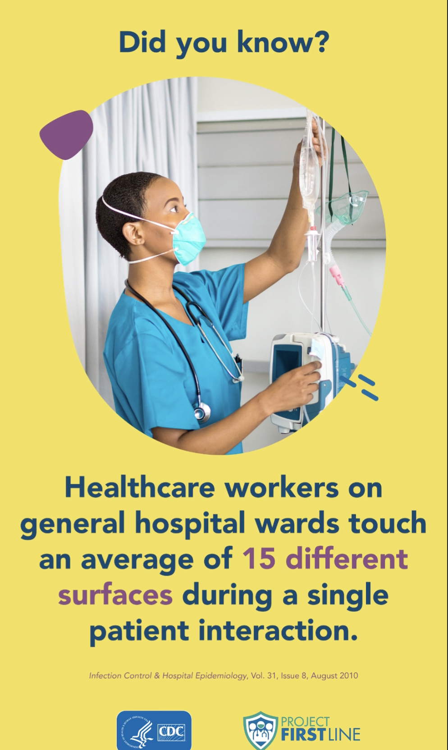
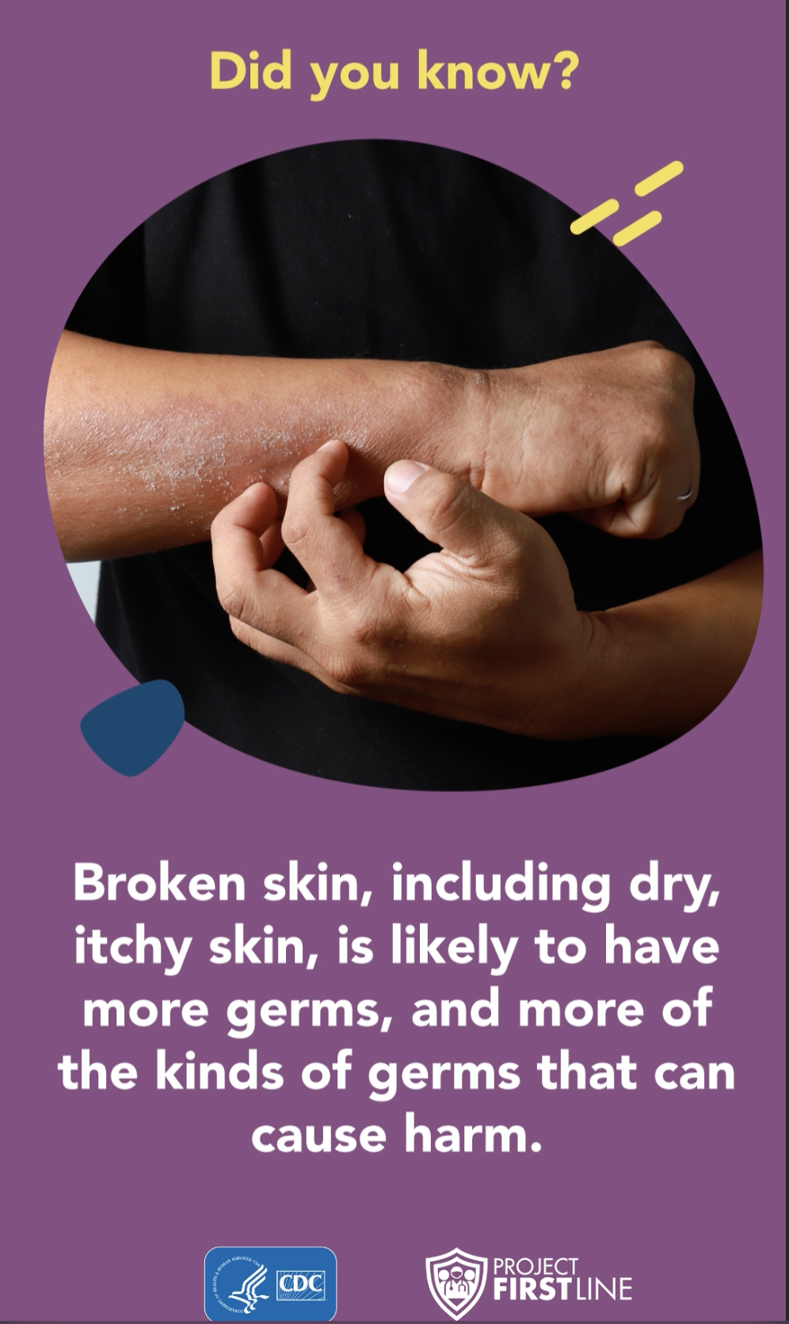
Project Firstline Infographics
CDC, 2022. Project Firstline videos-graphics
Notes:
Project Firstline has developed some useful infographics that can be helpful in delivering some very simple messages. The infographic on the left points out that healthcare workers touch many different surfaces during a single patient interaction. All of these surfaces need to be cleaned and disinfected regularly and in between patients. The infographic on the right is a reminder that healthcare workers must properly care for their skin. Dry and cracked skin may harbor microorganisms and those organisms may be transferred to patients and surfaces. Wear gloves when disinfecting surfaces and equipment to prevent the drying effects of those products on unprotected skin. Seek assistance from employee or occupational health if the healthcare worker experiences problems with their skin. Their employee health professionals may have ideas for resolution.

Slide 21
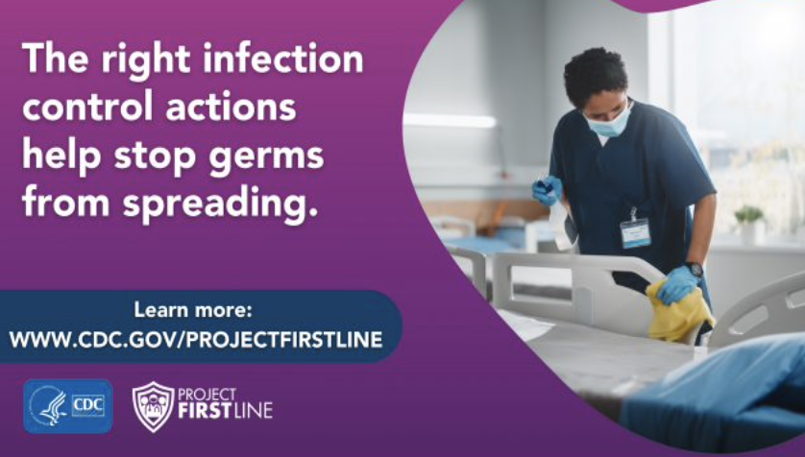
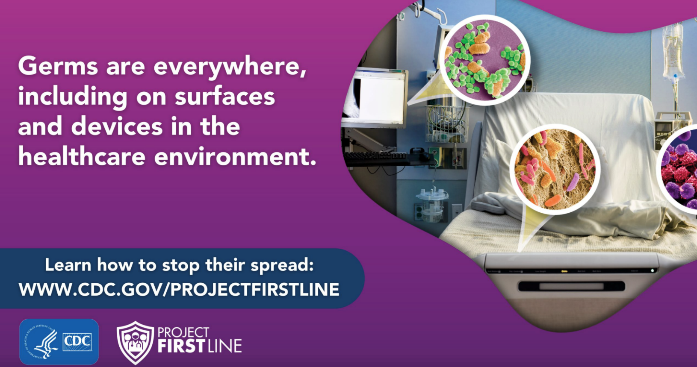
Project Firstline Infographics
CDC, 2022. Project Firstline videos-graphics
Notes:
Here are two more Project Firstline resources. The one on the top left shows how environmental cleaning and disinfection is an important way to prevent germs from spreading from patient to patient and between healthcare workers, patients, and their care environment.
The one on the fight reminds us the germs are everywhere. They live on surfaces and devices used in the healthcare environment. Reducing the risk of transmitting those germs depends upon cleaning and disinfection of the environment, reusable medical equipment, and consistent performance of hand cleaning.

Slide 22
TAKEWAY MESSAGES
When patients and healthcare personnel interact with the environment, surfaces become opportunities for contamination.
Contaminated surfaces that are touched by the hands of healthcare personnel and patients allow opportunities for movement of organisms from surfaces to hands, and from hands to surfaces.
Reusable medical equipment can serve as a reservoir for germs and must be part of a consistent and reliable environmental disinfection process.
Equipment that may be used as part of care with one patient, must be cleaned and disinfected before moving to another patient. If not properly cleaned and disinfected, the reusable medical equipment may serve as a vehicle for germ spread.
Germs cannot be seen, so standard practices must be part of a patient safety approach.
Notes:
Our key takeaway messages from this first simulation experience helps address the question as to why environmental contamination is an infection risk.
As we provide care, think about what opportunities for pathogen transmission were evident in the video. Do you see similar opportunities during your care activities?
What were the most striking learning points for you? Think about how you may take this information and make changes in your own practice.
Remember:
-When patients and healthcare personnel interact with the environment, surfaces become opportunities for contamination.
-Contaminated surfaces that are touched by the hands of healthcare personnel and patients allow opportunities for movement of organisms from surfaces to hands, and from hands to surfaces.
-Reusable medical equipment can serve as a reservoir for germs and must be part of a consistent and reliable environmental disinfection process.
-Equipment that may be used as part of care with one patient, must be cleaned and disinfected before moving to another patient for use. If not properly cleaned and disinfected, the reusable medical equipment may serve as a vehicle for pathogen transmission.
-Germs cannot be seen, so standardized and sustained practices must be part of a patient safety approach.

Slide 23
ELEMENTS OF A GERMICIDE LABEL
Germicide labels provide important information for the user.
What information is important to know when using a germicide?
List 5 important pieces of information:
  1. ________________
  2. ________________
  3. ________________
  4. ________________
  5. ________________
Notes:
We talked about some of the attributes of germicides and how that information is visually available on the product label. Think for a moment regarding information that is important when using a germicide.
What are 5 important pieces of information? There are more than 5, but think of those attributes that make a difference when you are thinking about use of a germicide for cleaning and disinfection.
-Is the germicide effective for the purpose?
-Does the germicide work in the presence of organic material? If I need to clean blood or other body fluids from the item before disinfection, is the germicide I am using effective for that purpose? What if I am disinfecting an item using as part of care with a patient who is experiencing C. difficile infection? Is that product sporicidal and able to kill the C. difficile spores?
Does the germicide provide cleaning and disinfection as a one-step process?
Does this germicide have a detergent and a disinfectant in the same product or do I need to clean first using one product then disinfect using another?
-What is the contact time?
Am I able to ensure that the surface I am disinfecting will be able to be untouched after I apply a sufficient amount of germicide? Is my cloth sufficiently wet with the germicide so I can apply enough product?
-Is the germicide safe for me to use?
Do I need to wear respiratory protection when using this germicide? If there is a spill, will it be safe for me to clean? Is additional ventilation required if I use this product?
-Do I need to mix the germicide or is it available for me to use in a ready-to-use format such as a wipe?
Environmental cleaning and disinfection is everyone’s job. Although Environmental Services personnel are the experts, all healthcare personnel should be aware of the need to clean and disinfect items they may take from person to person. Having the disinfectant readily available, helps make sure items such as blood glucose meters, blood pressure cuffs, electronic thermometers, and other items that may be shared among patients during a typical day have been properly cleaned and disinfected.
Think about other attributes or pieces of information you may want to know about germicides used in your setting to clean and disinfect reusable medical equipment.

Slide 24
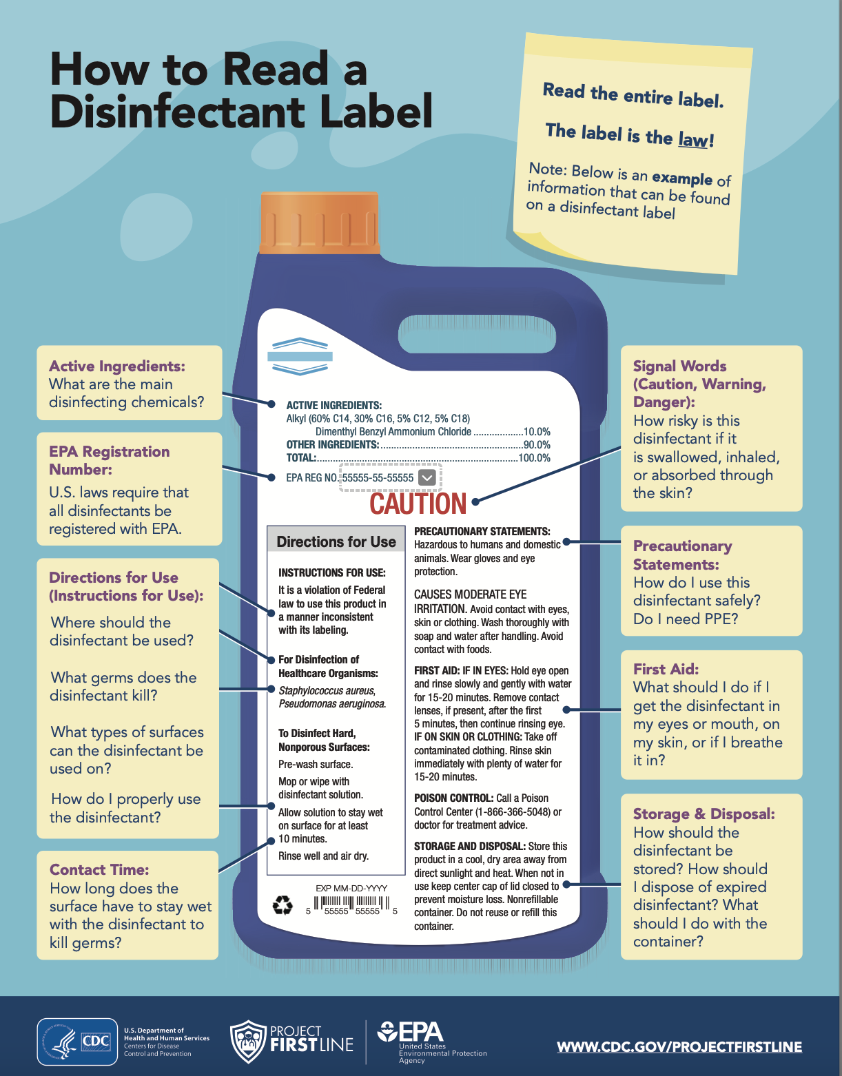
GERMICIDE LABEL
Locating the active ingredients
Reviewing instructions for use
Contact time
Using the disinfectant safely
Storage and disposal
CDC, 2022. Project Firstline videos-graphics
Notes:
As you think about these product attributes, remember that many of the pieces of information you need will be available on the product label.
Using this graphic from Project Firstline, find some of those attributes.
Look on the left side of that graphic showing a disinfectant label. Find the active ingredients. Look at the indications for use, and the contact time. On the right side of the label, you can see information regarding special precautions such as personal protective equipment needs and how to properly store and dispose of the chemical.
Other information is available on the Data Safety Sheet and the master label. Both of these are available from the manufacturer and the EPA. Your facility should maintain copies of these documents [paper or electronic], usually in the Environmental Services Department or the Risk Management Department.

Slide 25
DISINFECTION OF A SURFACE
Applying a germicide to a piece of reusable equipment or room surface requires that the germicide come into contact with the entire surface for a specified period of time.
This time is called: _______________________________.
Mechanical friction, or wiping, of the surface helps expose all surfaces. Wiping should be done:
  In a circular or back and forth motion with overlap to ensure complete contact
  OR
  In a back and forth motion taking care to avoid go over the same areas so inadvertent recontamination of an area is prevented
Notes:
Let’s test your recall. Applying a germicide to a piece of reusable equipment or room surface requires that the germicide come into contact with the entire surface for a specified period of time. This time is call: Contact Time.
To ensure appropriate contact time, the surface must be physically exposed to the germicide. Wiping of the surface helps make sure the entire surface comes into contact with the germicide.
There is a particular technique that is used to wipe a surface with a germicide. Should you use a circular or back and forth motion to provide overlap to ensure complete contact with the surface? Or, should you use a back and forth motion taking care to avoid going over the same area or areas so inadvertent recontamination of an area is prevented? You are right. Use a back and forth motion so you wipe the area applying the germicide and do not go back over that same area. Watch what you are doing so you wipe and apply the germicide to the complete surface.

Slide 26
DISINFECTION OF A SURFACE
What did you notice regarding the wiping of a surface with a disinfectant wipe?
What would you have done differently?
What questions do you have about that disinfectant wipe?
How did you determine how many wipes to use to disinfect that surface?
Developed by the Kentucky Infection Prevention Training Center (KyIP, 2022). Used with permission.
Notes:
Let’s watch this video showing several different ways individuals may have cleaned and disinfected a surface.
Now that you have watched the video:
What did you notice regarding the wiping of a surface? What would you have done differently now that you have new knowledge about germicides and how they work? What questions do you have about that disinfectant wipe? How did you determine how many wipes to use to disinfect that surface?
In the video you can see the impact of a wipe without friction [the fluorescent marker is still visible], an incomplete wipe [the fluorescent marker is untouched], and a surface that has been appropriately disinfected using manual friction and in ways that completely expose the entire surface to the disinfectant through a methodical approach to wiping. The fluorescent marker has been removed.
A single wipe may not be able to provide enough of the liquid germicide to the surface if the wipe has been allowed to dry or if the surface area is too large. If you can see that there is wetness on the surface, you can tell if there has been exposure to all areas of the surface. If there is limited about of wetness and the surface dries immediately, the wipe may not have been wet enough or the surface area was too large to be properly disinfected with a single wipe. There is no single ‘formula’ for how many wipes are needed for a given surface. The approach is to wet the surface entirely with enough germicide so it continues to have contact with the item while it dries. Leave the area undisturbed for the contact time.

Slide 27
APPLYING KNOWLEDGE USING THE SPAULDING CLASSIFICATION
The Spaulding Classification provides a framework that can be used to determine how to disinfect a particular surface or piece of equipment based upon its intended use.
Use the following table that lists commonly used pieces of equipment that should be disinfected prior to next patient use. Identify the Spaulding Classification category and the level of disinfection needed.
Be prepared to share why you made your selections.
Notes:
Our last simulation helps take what we have learned about disinfection and applies it to items you may commonly use in your healthcare setting. The next slide will have a chart for you to complete. You will have the piece of reusable medical equipment listed, and you will select which level of risk, according to the Spaulding Classification, applies to that item [non-critical, semi-critical, or critical]. You will then assign the appropriate germicide level [low- or intermediate-level, high-level, or sterilization] for that item.

Slide 28
Equipment or Surface | Spaulding Classification Category |  |  | Type of Disinfection
 | Non-Critical | Semi-Critical | Critical | Low- Level or Immediate-Level Disinfection | High-Level Disinfection | Sterilization
Example: Blood Pressure Cuff | X |  |  | X
Surgical Instrument
Patient bedrails
Glucose meter
Resident’s wheelchair
Laryngoscope blade
Ultrasound probe checking for pulses
Vaginal ultrasound probe
Bedside commode
IV pole
Electronic thermometer
Stethoscope used in isolation room
Stethoscope used in patient/resident room not isolation
Notes:
Here is our chart. Take a look at the list of items down the left hand column. Think about what the item is used for and what type of patient contact occur. Remember, items used for non-critical activities come into contact with intact skin. Semi-critical activities allow items to come into contact with mucous membranes, and critical activities allow items come into contact with sterile body sites and sterile tissue.
The next slide shows the answers and the rationale

Slide 29
Equipment or Surface | Spaulding Classification Category |  |  | Type of Disinfection
 | Non-Critical | Semi-Critical | Critical | Low or Immediate Level Disinfection | High-Level Disinfection | Sterilization
Example: Blood Pressure Cuff | X |  |  | X
Surgical Instrument |  |  | X |  |  | X
Patient bedrails | X |  |  | X
Glucose meter | X |  |  | X
Resident’s wheelchair | X |  |  | X
Laryngoscope blade |  | X |  |  | X
Ultrasound probe checking for pulses | X |  |  | X
Vaginal ultrasound probe |  | X |  |  | X
Bedside commode | X |  |  | X
IV pole | X |  |  | X
Electronic thermometer | X |  |  | X
Stethoscope used in isolation room | X |  |  | X
Stethoscope used in patient/resident room not isolation | X |  |  | X
Notes:
Here is our chart with the answers.
Let’s take each row and review:
Patient bedrails come in contact with intact skin so low- or intermediate-level disinfection is appropriate.
Glucose meter comes into contact with intact skin so low- or intermediate-level disinfection is appropriate. Remember, nothing on the meter should be touching the area where the patient’s finger has been lanced for blood sugar monitoring.
Resident’s wheelchair comes into contact with intact skin so low- or intermediate-level disinfection is appropriate. If the wheelchair comes into contact with stool and the patient has C. difficile, then a sporicidal agent should be used to clean and disinfect.
A laryngoscope blade comes into contact with the mucous membranes of the throat and should be handled as semi-critical and high level disinfection used
A ultrasound probe used to check pulses on intact skin should be cleaned then disinfected with a low- or intermediate-level disinfectant.
A vaginal ultrasound probe comes into contact with mucous membranes and should be high-level disinfected
A bedside commode comes into contact with with intact skin so low- or intermediate-level disinfection is appropriate. However, if the patient is in isolation for C. difficile, a sporicide should be used.
An IV pole comes in contact with with intact skin, primarily of the healthcare worker, so low- or intermediate-level disinfection is appropriate. If contamination with a bloodborne pathogen occurs, an intermediate-level disinfectant capable of killing those pathogens should be used.
An electronic thermometer comes into contact with intact skin so low- or intermediate-level disinfection is appropriate. The probe that enters the patient’s mouth should be covered with a disposable cover and the probe itself should also be disinfected if being used patient to patient
Stethoscope used in an isolation room should contact into contact with intact skin so low- or intermediate-level disinfection is appropriate.
A stethoscope used in an isolation environment should also come into contact with intact skin and can be disinfected using a low- or intermediate-level disinfectant as the hospital-grade disinfectants are designed to address the pathogens often seen in healthcare settings. However, items used in isolation environments are often disposable. If items are deemed as single patient use, they should be discarded and not reused, even if disinfected.

Slide 30
TAKEAWAY POINTS
Environmental cleaning of reusable medical equipment is a patient safety responsibility of healthcare personnel as germs may contaminate equipment and serve as a vehicle of germ spread.
Equipment should be cleaned and disinfected between patients using an appropriate healthcare-grade disinfectant as these germicides are selected to best address the types of organisms identified in healthcare settings.
The Spaulding Classification should be used as a guide for determining how to disinfect equipment thereby enabling consistent and standardized approaches.
Disinfectants should be used according to manufacturer instructions to ensure appropriate dilution and contact time.
Contact time helps ensure germs are exposed to appropriate disinfectants for adequate time to kill and ultimately reduce the risk of spreading germs to patients and to healthcare personnel.
Notes:
During this learning activity, we have talked about the need to ensure that reusable medical devices and equipment are cleaned and disinfected properly so they are not able to be part of pathogen transmission. Points to remember include:
Environmental cleaning of reusable medical equipment is a patient safety responsibility of healthcare personnel as germs may contaminate equipment and serve as a vehicle of transmission to other patients.
Equipment should be cleaned and disinfected between patients using an appropriate hospital-grade disinfectant as these germicides are selected to best address the types of organisms identified in healthcare settings.
The Spaulding Classification should be used as a guide for determining how to disinfect equipment thereby enabling consistent and standardized approaches.
Disinfectants should be used according to manufacturer instructions to ensure appropriate dilution, contact time, and use.
Contact time helps ensure microorganisms are exposed to appropriate disinfectants for adequate time to kill and ultimately reduce transmission risk to patients and to healthcare personnel.
Thank you for the opportunity to talk about the importance of cleaning and disinfection of reusable medical devices and equipment.

Slide 31
References
Centers for Disease Control and Prevention (CDC). (2022). Health equity guiding principles for inclusive communication. Centers for Disease Control and Prevention. Retrieved December 27, 2022, from www.cdc.gov/healthcommunication/Health_Equity.html
Centers for Disease Control and Prevention (CDC). (2022). Current HAI progress report. Centers for Disease Control and Prevention. Retrieved December 27, 2022, from http://www.cdc.gov/hai/data/portal/progress-report.html
Centers for Disease Control and Prevention (CDC). (2021, May 25). “Episode 20: Why Do Cleaning and Disinfection Matter in Healthcare?” [Video]. YouTube. https://www.youtube.com/watch?v=WpV_dsKQDMg.
Society for Simulation in Healthcare. (2022). About Simulation. Retrieved November 23, 2022, from https://www.ssih.org/About-SSH/About-Simulation

Slide 32
References
Carrico RM, Coty MB, Goss LK, LaJoie AS. (2007). Changing health care worker behavior in relation to respiratory disease transmission with a novel training approach that uses biosimulation. American Journal of Infection Control. 35(1): p. 14-9.
Carrico R, Rebmann T, English JF, Mackey J, Cronin. (2008). Infection prevention and control competencies for hospital-based health care personnel. American Journal of Infection Control. 36(10):691-701. PMID: 19084164.
CDC (2017). Healthcare Infection Control Practices Advisory Committee. Core Infection Prevention and Control Practices for Safe Healthcare Delivery in All Settings—Recommendations of the Healthcare Infection Control Practices Advisory Committee (HICPAC). Updated November 2022. Retrieved December 12, 2022, from https://www.cdc.gov/infectioncontrol/guidelines/core-practices/index.html

Slide 33
References
CDC (2008). Guideline for Disinfection and Sterilization in Healthcare Facilities, 2008. Retrieved November 23, 2022, from http://www.cdc.gov/hicpac/pdf/guidelines/Disinfection_Nov_2008.pdf
US Department of Labor. (1992). Occupational Safety & Health Administration. 29 CFR 1910.1030 Bloodborne Pathogens. https://www.osha.gov/pls/oshaweb/owadisp.show_document?p_id=10051&p_table=STANDARDS Accessed November 23, 2022.
Rutala WA, Weber DJ. (2016). Disinfection and Sterilization in Health Care Facilities: An Overview and Current Issues. Infect Dis Clin North Am. Sep; 30(3):609-37.
EPA (2020). About List N: Disinfectants for COVID-19. Retrieved December 12, 2022, from https://www.epa.gov/coronavirus/about-list-n-disinfectants-coronavirus-covid-19-0

Slide 34
references
Spaulding EH. (1968). Chemical disinfection of medical and surgical materials. In: Lawrence C, Block SS, eds. Disinfection, sterilization, and preservation. Philadelphia: Lea & Febiger, 1968:517-31.

