Slide 1
Environmental Cleaning and Disinfection
Kirsten Trudeau MSN APRN FNP-C
Advanced Practice Provider-Nurse Specialist
Norton Infectious Diseases Institute
Notes:
Hello, and thank you for joining today. My name is Kirsten Trudeau, and I am a nurse practitioner at Norton Infectious Diseases Institute. The focus of this presentation is on environmental cleaning and disinfection. Decreasing pathogens via cleaning and disinfection is vital to control the spread of infection, prevention of hospital acquired infections, and reducing the risk of antimicrobial resistance. Today we will learn about the importance of cleaning and disinfection, as well as how to implement and monitor in your facility.

Slide 2

Funding for this presentation provided by the Kentucky Department for Public Health.
Content includes discussion of unlabeled use of products. Presenter has no financial interests or other relationships with the manufacturers of products. No commercial support was provided for this educational activity.
Notes:
Funding for this presentation provided by the Kentucky Department for Public Health.
Content includes discussion of unlabeled use of products. Presenter has no financial interests or other relationships with the manufacturers of products. No commercial support was provided for this educational activity.

Slide 3
Objectives
Discuss the importance of proper cleaning and disinfection techniques in healthcare settings to prevent the transmission of pathogens
Analyze the impact of inadequate cleaning and disinfection practices on patient outcomes
Identify correct disinfectants based on the surface and contamination
Demonstrate effective technique and frequency for cleaning and disinfecting based on guidelines and manufacturer’s instructions for use
Apply tools to monitor and evaluate cleaning and disinfection efforts
Notes:
By the end of this presentation you should be able to:
Understand the importance of proper cleaning and disinfection techniques in healthcare settings to prevent the transmission of pathogens
Analyze the impact of inadequate cleaning and disinfection practices on patient outcomes
Identify correct disinfectants based on the surface and contamination
Demonstrate effective technique and frequency for cleaning and disinfecting based on guidelines and manufacturer’s instructions for use
Apply tools to monitor and evaluate cleaning and disinfection efforts

Slide 4
Pathogens and the environment
Pathogens are everywhere
Some are not harmful, while others are
Live in reservoirs
Spread via a variety of pathways
(CDC, 2022c)
Notes:
We will start off with some basics. pathogens are everywhere. Some pathogens are not harmful, while other can be. pathogens live and thrive in reservoirs, and find ways to spread via pathways. Generally speaking pathogens don’t just grow legs and walk to their next host. The are transported there through touching contaminated surfaces or object. They can also be propelled via splashes, droplets, or aerosolized particles. Regardless of the mode of transmission, it is important that we make every effort to prevent the spread of infection.
Centers for Disease Control and Prevention (CDC). (March 11, 2022). Learn Where Germs Live in Healthcare. Project Firstline. Learn Where Germs Live in Health Care | Project Firstline | Infection Control | CDC

Slide 5
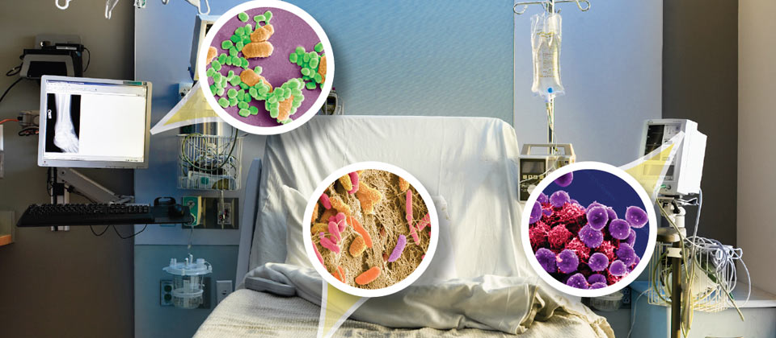
Reservoirs
Reservoirs-pathogens live everywhere
  Water
  Wet or moist environments
  Dry surfaces
  Dirt
  Dust
  Devices
(CDC, 2022b)
Notes:
Reservoirs--Where can pathogens live? They live everywhere! Water, wet surfaces, dry surfaces like your body, air, high touch surfaces (door handles, bed rails, call lights, counters), dirt and dust in the air (which become a big problem when construction is being performed), devices (indwelling can lead to pathogens entering the body). All of these reservoirs are concerning and could lead to a person getting an infection.
Centers for Disease Control and Prevention (CDC). (March 11, 2022). Germs Live in the Environment. Project Firstline. Germs Live in the Environment | Project Firstline | Infection Control | CDC

Slide 6
What is a fomite?
Inanimate objects
Can harbor colonized bacteria
May serve as a step in the pathway of transmission to the host
(Stephens et al, 2019)
Notes:
What does the path to the host look like? It could involve the help of a fomite. A fomite is an inanimate object that harbors colonized bacteria. That bacteria can then move through a pathway finding an opening to a host. A good example of this might be the patient’s call light. If not cleaned and disinfected, there might be colonized bacteria living on the call light (the fomite), and the patient uses the call light. That bacteria then moves to the patient’s hands effectively contaminating them. At that point, the pathogens could find an opening via an indwelling device, mucous membranes, or even a surgical wound.
Other items to highlight are those that move from room to room. These might be blood pressure cuffs, pulse oximeters, dopplers. Who is cleaning these items? Cleaning and disinfection is everyone’s responsibility. If you had your team use dots of various colors to show which items each of them think they are responsible for cleaning, would the dots be evenly distributed?
Stephens, B., Azimi, P., Thoemmes, M. S., Heidarinejad, M., Allen, J. G., & Gilbert, J. A. (2019). Microbial Exchange via Fomites and Implications for Human Health. Current pollution reports, 5(4), 198–213.
https://doi.org/10.1007/s40726-019-00123-6

Slide 7
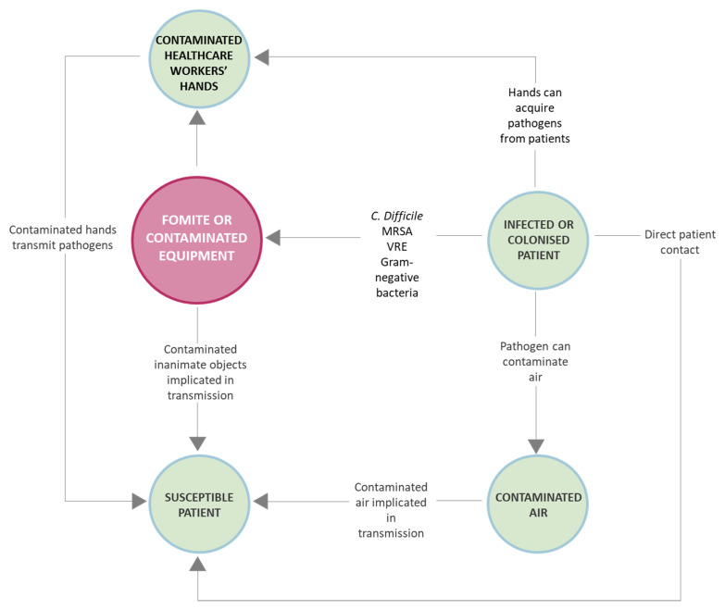
Transmission
Contact
Sprays and splashes
Inhalation
Sharps injuries
(Artasensi, Mazzotta, Fumagalli, 2021; CDC, 2022d)
Notes:
Transmission occurs via contact, sprays, splashes, inhalation, or sharps injuries. You can see from this graph that there are many pathways for pathogens to reach a susceptible patient. Direct patient contact, contaminated healthcare workers hands, fomites or contaminated equipment, and/or contaminated air. These pathogens can cause hospital acquired infections or HAIs. You will also notice that this is a pathway that continues. How might we prevent those pathogens from getting to the susceptible patient? Finding a way to break the pathway before the pathogen makes it to the patient will prevent an infection. Cleaning and disinfection can and will do that.
Artasensi, A., Mazzotta, S., & Fumagalli, L. (2021). Back to Basics: Choosing the Appropriate Surface Disinfectant. Antibiotics (Basel, Switzerland), 10(6), 613. https://doi.org/10.3390/antibiotics10060613
Back to Basics: Choosing the Appropriate Surface Disinfectant - PMC (nih.gov)
Centers for Disease Control and Prevention (CDC). (March 24, 2022). Recognize Infection Risks in Health Care. Project Firstline. Recognize Infection Control Risks in Health Care | Project Firstline | CDC

Slide 8
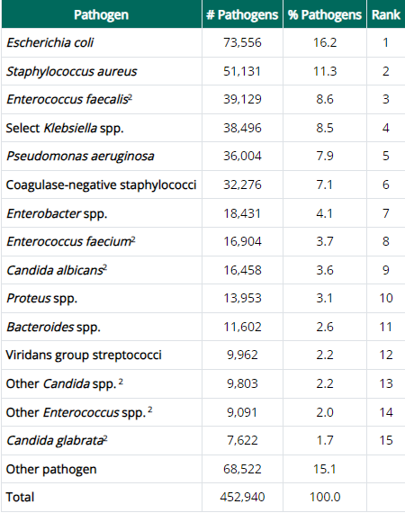
The Top 15 HAI Pathogens Reported to NHSN, Adults, 2018 – 2021
(CDC, 2023b)
Notes:
According the CDC, these are the top 15 pathogen responsible for HAIs from 2018 to 2021 which were reported to the NHSN. It might be helpful to review your facility’s disinfectants and compare them to this list of pathogens. By targeting these specific pathogens with disinfectants, the pathways to the susceptible patients can be disrupted and prevent future HAIs.
The Top 15 HAI Pathogens Reported to NHSN, Adults, 2018 – 2021
Centers for Disease Control and Prevention (CDC). (July 28, 2023). HAI Pathogens and Antimicrobial Resistance Report, 2018-2021. HAI Pathogens and Antimicrobial Resistance Report, 2018-2021 | NHSN | CDC
HAI Pathogens and Antimicrobial Resistance Report, 2018-2021 | NHSN | CDC

Slide 9
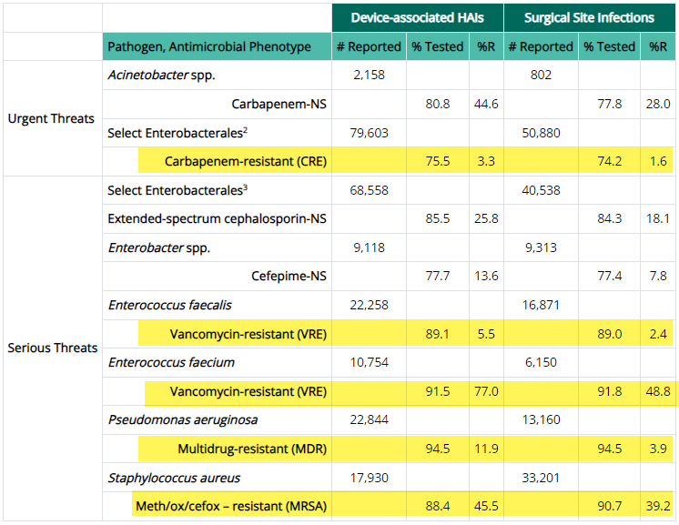
Antimicrobial Resistance Threats
(CDC, 2023b)
Notes:
Highlight rows of disinfectant
Antimicrobial Resistance Threats-additionally the threats posed from antibiotic resistant pathogens were also reported to the NHSN during the same time period. Of the pathogens likely to cause HAIs, these were the ones tested and found to be resistant to selected antimicrobials making them serious or urgent threats in the world of healthcare. This underscores the importance of having disinfectants that are efficacious to these pathogens, but also clear policies, procedures and monitoring efforts in place to effectively kill these pathogens and prevent HAIs. Additionally it might be beneficial to study your local antibiogram to see what resistant bacteria your facilitiy faces locally. Again comparing this to the kill claim of your disinfectants might could decrease the risk of infections caused by these pathogens.
Centers for Disease Control and Prevention (CDC). (July 28, 2023). HAI Pathogens and Antimicrobial Resistance Report, 2018-2021. HAI Pathogens and Antimicrobial Resistance Report, 2018-2021 | NHSN | CDC
HAI Pathogens and Antimicrobial Resistance Report, 2018-2021 | NHSN | CDC

Slide 10
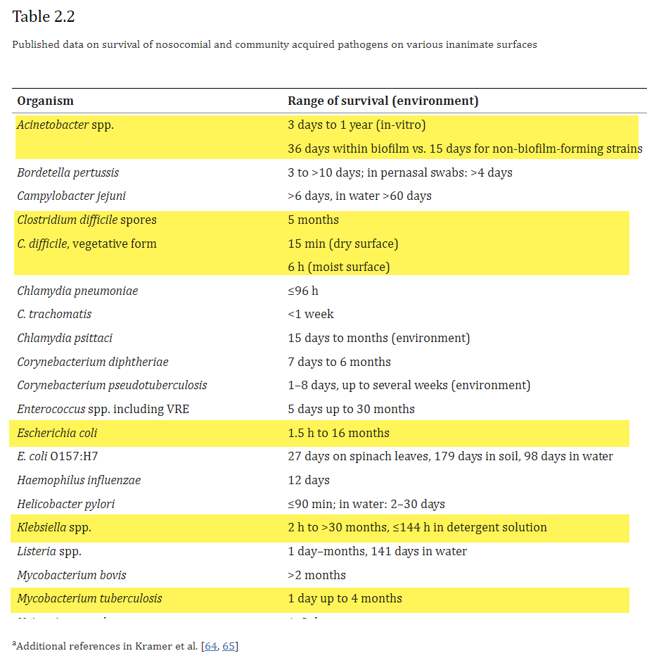
Pathogen Lifespan
(Kramer & Assadian, 2014)
Notes:
Every pathogen is different. Each has it’s own unique structural make-up. This makes killing them particularly difficult at times. This slide and the next show the lifespans of pathogens found to cause both nosocomial and community infections found on inanimate surfaces. The range is wide some pathogens only lasting 15 minutes, while others living over a year. This again supports the need effective cleaning and disinfection practices.
Kramer, A., & Assadian, O. (2014). Survival of Microorganisms on Inanimate Surfaces. Use of Biocidal Surfaces for Reduction of Healthcare Acquired Infections, 7–26. https://doi.org/10.1007/978-3-319-08057-4_2
Highlight acinitobacter and others which are really important, c diff spores and vegetative

Slide 11
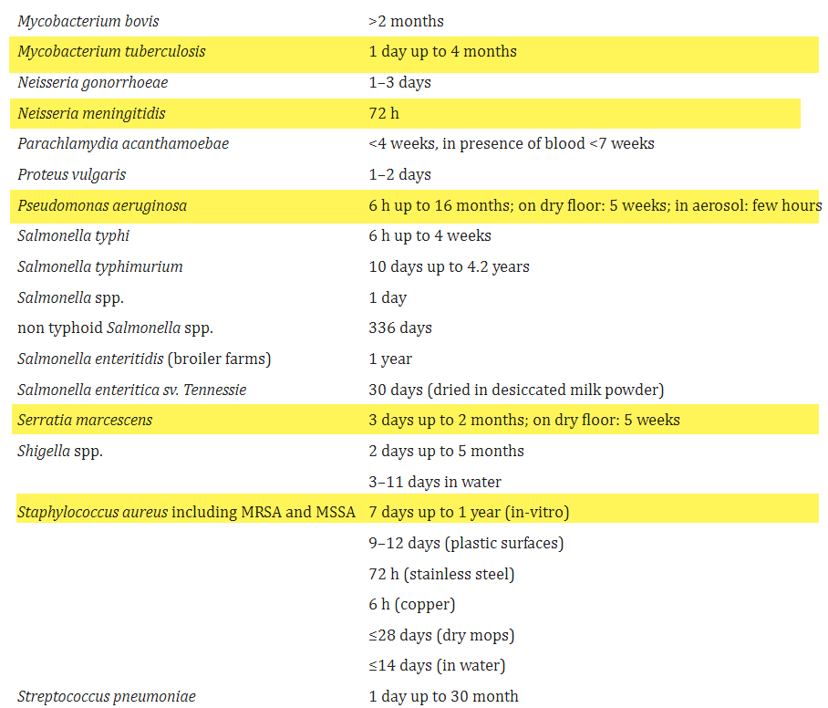
Pathogen Lifespan
(Kramer & Assadian, 2014)
Notes:
Mycobacterium (kill time 10 minutes vs 3), MRSA, MSSA, strep pneumo, pseudomonas (splash zones)
Kramer, A., & Assadian, O. (2014). Survival of Microorganisms on Inanimate Surfaces. Use of Biocidal Surfaces for Reduction of Healthcare Acquired Infections, 7–26. https://doi.org/10.1007/978-3-319-08057-4_2
Survival of Microorganisms on Inanimate Surfaces - PMC (nih.gov)

Slide 12
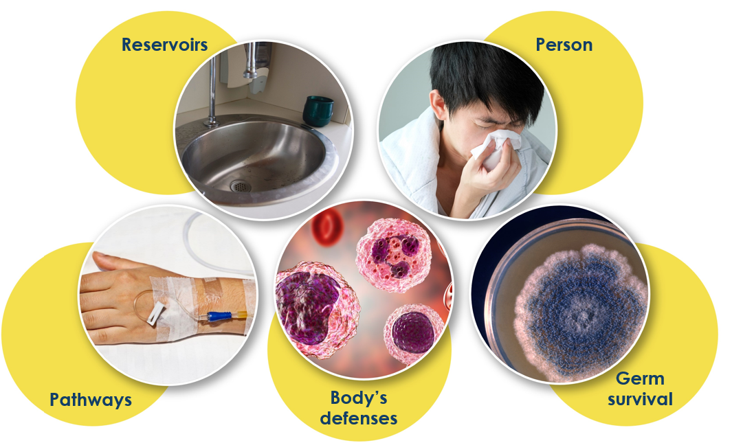
Five Elements of How Germs Spread
(CDC, 2023d)
Notes:
I think it is important to go back to the basics of how infections actually occur. pathogen enter the host, multiply and cause the body to react
Pathogens enter the host, multiply and cause the body to react
Reservoir
Pathway
A person to infect (Host)
Survival
The key to stopping the process is to stop the spread of germs. Environmental cleaning and disinfection provides an opportunity to do that
To think of this process from an clinical lens-a pathogen can live on a bed rail. The nurse might put the bed rail down and administer medication through the patient's central line without performing hand hygiene. The pathogen from the bed rail (the source), was transmitted by the nurse into the susceptible host who had an opening with an indwelling device. Now the patient is at risk for a bloodstream infection.
Chain of Infection Components (cdc.gov)
How Infections Spread | Infection Control | CDC

Slide 13
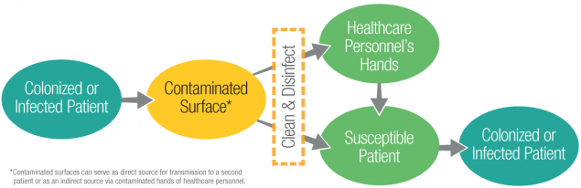
Contaminated Surface to Patient
(CDC, 2020)
Notes:
This is a great diagram of using cleaning and disinfection to prevent pathogens on a contaminated surface from reaching a susceptible patient. You can also see here that this can be an ongoing cycle without proper cleaning and disinfection. You have the colonized or infection patient who contaminates a surface, the healthcare worker or another susceptible patient touches that surface. The susceptible patient then becomes colonized or infected.
Center for Disease Control and Prevention (CDC). (October, 13, 2020). Reduce Risk for Surfaces. Reduce Risk from Surfaces | HAI | CDC

Slide 14
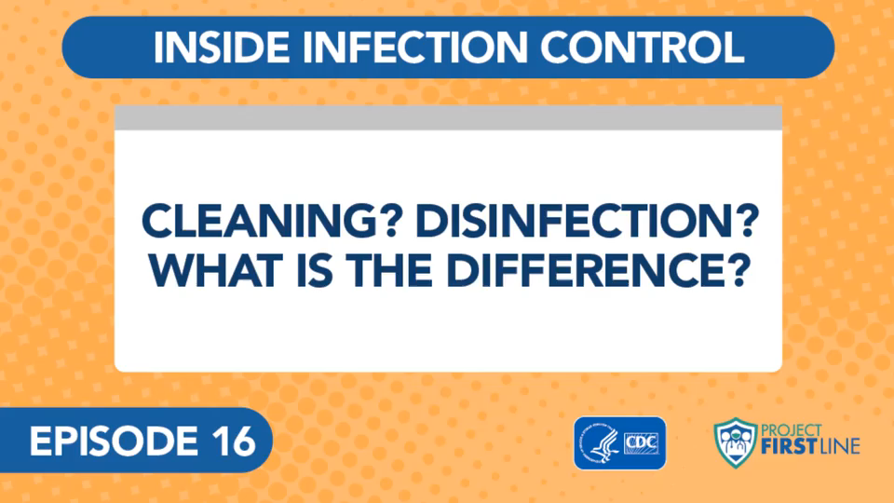
Cleaning vs Disinfection
Cleaning-manually removing visible soil
Disinfection-complete or nearly all removal of pathogen life on non-living objects
(CDC, 2022d)
Notes:
Cleaning-involves manually removing visible soil from objects or surfaces. This can also be done mechanically. Usually water is used with a detergent product or an enzymatic product.
Disinfection-complete or nearly all removal of pathogen life on non-living objects
Excludes bacterial spores
Cleaning and disinfection can be done in two steps or there are products that can do both steps in one. The use of the products will depend on the surface and the situation.
Example of cleaning dishes before dishwasher
Centers for Disease Control (CDC). (January 28, 2022). Cleaning? Disinfection? What is the Difference? cdc.gov/infectioncontrol/projectfirstline/videos/Ep16-CLEANING-LoRes.mp4

Slide 15
Importance of cleaning and disinfection
Prevents transmission of hospital-acquired infections (HAIs)
Significantly decreases rates of multi-drug resistant organisms (MDROs)
Decreases overall infection rates among patients
(Weber et al., 2013)
Notes:
It is important to stress the impact of exceptional cleaning and disinfection processes. Cleaning and disinfection
Prevents transmission of hospital-acquired infections (HAIs)
Significantly decreases rates of multi-drug resistant organisms (MDROs)
Decreases overall infection rates among patients
INSERT CASE HERE
*1-s2.0-S0196655322003339.pdf (clinicalkey.com)
Weber, David J.a,b; Anderson, Deverickc; Rutala, William A.a,b. The role of the surface environment in healthcare-associated infections. Current Opinion in Infectious Diseases 26(4):p 338-344, August 2013. | DOI: 10.1097/QCO.0b013e3283630f04

Slide 16

Core Components of Environmental Cleaning and Disinfection
Integrate in the culture of safety within the hospital
Educate and train all healthcare providers
Select correct tools for cleaning and disinfection through technology or products
Create standardized protocols
Monitor adherence
Provide feedback on monitoring results
(CDC, 2020)
Notes:
In an effort to strengthen cleaning and disinfection practices, the CDC has developed Core Components of Environmental Cleaning and Disinfection. These include:
Integrate in the culture of safety within the hospital-safety is an initiative for all healthcare settings and including safety from an environmental prospective is key to integrating the vital role of EVS in the healthcare settings.
Educate and train all healthcare providers-while education is key for EVS workers, it is not just the job of EVS. It is everyone’s responsibility to ensure cleaning and disinfection policies are followed. Proper education is the basis of this step.
Select correct tools for cleaning and disinfection through technology or products-careful selection requires input from infection prevention experts and also requires staying up to date on technology and innovation.
Create standardized protocols-by having a standard protocol, you can support tasks being performed in the correct manner every time regardless of the person performing the task. Additionally, staff must have the resources to abide by this protocol
Monitor adherence-monitoring for adherence is key to ensuring everyone is following the standardized protocols. If adherence takes a tumble, what happened? Was there a change in product availability? Staff turnover? Lack of knowledge. Monitoring shows gaps and allows a change to intervene.
Provide feedback on monitoring results-monitoring gives us the chance to provide prompt feedback. It also allows for results monitoring and comparison to other related data like HAIs.
Center for Disease Control and Prevention (CDC). (October, 13, 2020). Reduce Risk for Surfaces. Reduce Risk from Surfaces | HAI | CDC

Slide 17
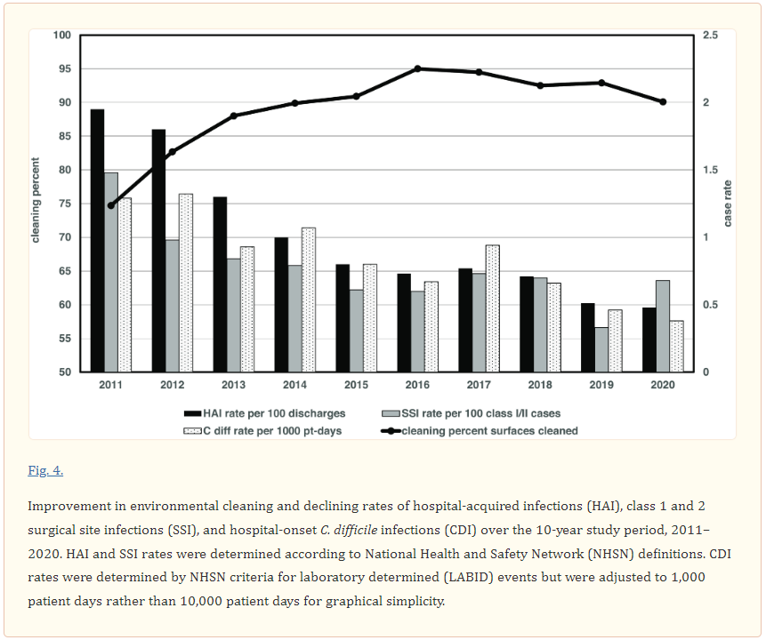
Effects of EVS education, monitoring, and feedback process
(Parry et al., 2022)
Notes:
This study published in the Antimicrobial stewardship and healthcare epidemiology journal should the effects and sustainability of formal education, monitoring and feedback over the course of 11 years. This took place at Stamford Hospital in Connectivut, and 305 bed hospital. This hospital has now sustained surface cleaning performance at >90% for the last six years and saw dramatic decreases in HAIs. Particularly c diff and ssi by 75 and 55 percent respectively.
Parry, M. F., Sestovic, M., Renz, C., Pangan, A., Grant, B., & Shah, A. K. (2022). Environmental cleaning and disinfection: Sustaining changed practice and improving quality in the community hospital. Antimicrobial stewardship & healthcare epidemiology : ASHE, 2(1), e113. https://doi.org/10.1017/ash.2022.257

Slide 18
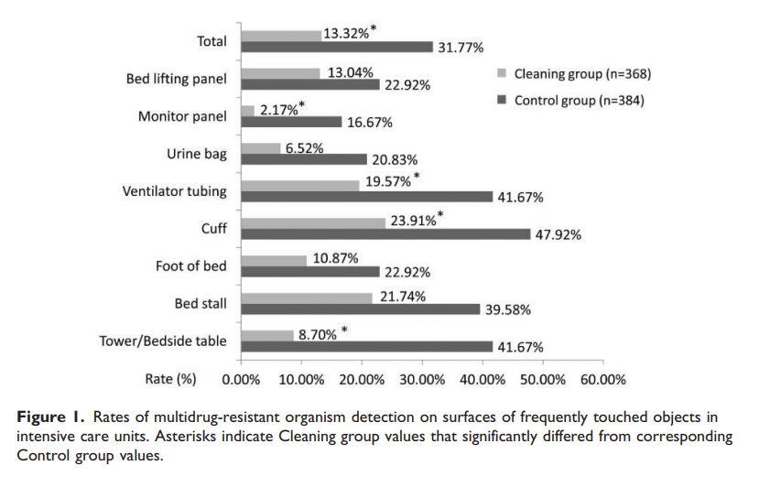
MDRO Reduction
(Huang et al., 2020)
Notes:
This graph is from a study out of China published in The Journal of International Medical Research. The study took places in ICUs at 7 tertiary hospitals in China from October 2013 to February 2017. This was a cross sectional study performing MDRO screening before enhanced cleaning and after. Before being the control group and after being the interventional group. MALDI testing was used, and the goal was to analyze MDRO colonization/infection and the relationship to environmental bacteria. 196 patients were enrolled. The enhanced cleaning group showed surface MDRO rates decreased from 32% to 13%, effectively shortening ICU length of stay and risk of mortality. This graph nicely depicts the effects of enhanced cleaning methods on surfaces. The rates of MDRO significantly decreased.
METHOD: “Environmental cleaning
All medical staff and cleaning staff in the ICUs of the seven medical centers received training regarding the enhanced cleaning and disinfection methods, as well as the intensity and frequency at which they should be performed. During the baseline period, conventional cleaning methods were performed; one clean cloth was soaked in 500 to 1000 mg/L sodium hypochlorite, then used to wipe patient areas that were frequently touched by health care workers. The cloth was then soaked in sodium hypochlorite disinfectant and reused to clean the next patient area. During the enhanced cleaning period, cleaning and disinfection methods were performed in accordance with the literature.¹³ Trained nurses were responsible for the daily and terminal cleaning and disinfection of the surfaces of diagnostic and therapeutic equipment and instruments. Trained environmental service workers were responsible for the daily and terminal cleaning and disinfection of the surfaces of other environmental objects. Daily cleaning comprised wiping the surface of environmental objects with quaternary ammonium salt disinfectant wipes (CaviWipes, Metrex, Orange, CA, USA), twice per day; terminal room disinfection comprised wiping with 500 mg/L sodium hypochlorite and the application of ultraviolet irradiation. MDRO monitoring (as described in the “MDRO outcome measurements” section) was carried out to assess the surfaces of frequently touched objects around each patient; when a bed became available, new patients could be accepted only after no MDROs had been detected.”
Huang, J., Cui, C., Zhou, S., Chen, M., Wu, H., Jin, R., & Chen, X. (2020). Impact of multicenter unified enhanced environmental cleaning and disinfection measures on nosocomial infections among patients in intensive care units. The Journal of international medical research, 48(8), 300060520949766. https://doi.org/10.1177/0300060520949766
*Impact of multicenter unified enhanced environmental cleaning and disinfection measures on nosocomial infections among patients in intensive care units (sagepub.com)

Slide 19
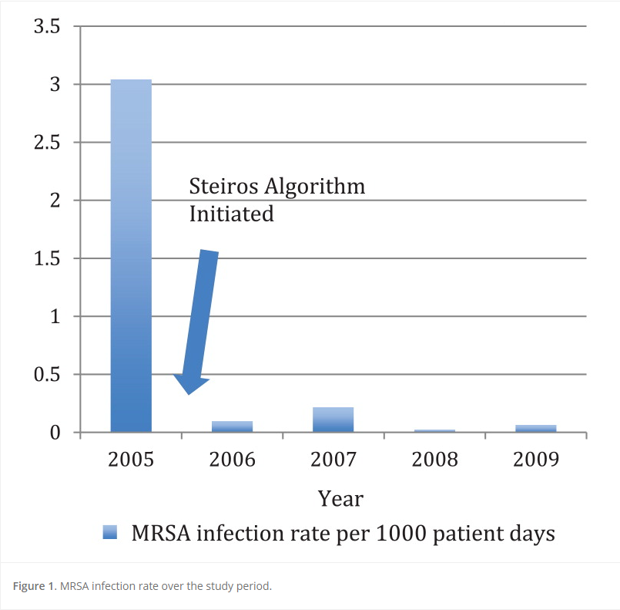
Environmental and patient cleaning protocol
(Watson P., Watson L., Torress-Cook, 2016)
Notes:
Environmental and patient cleaning protocol
A study published in the Journal of Infection Control in 2016 looked at the efficacy of a hospital-wide environmental cleaning protocol on HAI MRSA rates. This was a retrospective, pre-post interventional study. This was one large hospital in California. HAI MRSA rates were reviewed from January 2005 to September 2009. Implementation took place January 2006. The infection rate as well as cost analysis were review. MRSA rates dropped by 96% and saved the hospital 1.6 million dollars.
Watson, P. A., Watson, L. R., & Torress-Cook, A. (2016). Efficacy of a hospital-wide environmental cleaning protocol on hospital-acquired methicillin-resistant Staphylococcus aureus rates. Journal of infection prevention, 17(4), 171–176. https://doi.org/10.1177/1757177416645342
Efficacy of a hospital-wide environmental cleaning protocol on hospital-acquired methicillin-resistant Staphylococcus aureus rates - Paul Andrew Watson, Luke Robert Watson, Alfonso Torress-Cook, 2016 (sagepub.com)
96% reduction of MRSA rates and cost savings of 1.6 million dollars

Slide 20
High Touch Surfaces
Bedrails
IV poles
Sink handles
Bedside tables
Preparation counters
Privacy curtain at open/close edges
Equipment for patient use/monitoring
Equipment to transport
Call lights/remotes
Doorknobs
Light switches
(CDC, 2023)
Notes:
What surfaces are we most worried about?
High Touch Surfaces- these include
Bedrails
IV poles
Sink handles
Bedside tables
Preparation counters
Privacy curtain at open/close edges
Equipment for patient use/monitoring
Equipment to transport
Call lights/remotes
Doorknobs
Light switches
Centers for Disease Control and Prevention (CDC). (May 4, 2023). Examples of high-touch surfaces in a specialized patient area. Appendix C: Examples of High-Touch Surfaces | Environmental Cleaning in Global Healthcare Settings | HAI | CDC
Environmental Cleaning Procedures | Environmental Cleaning in Global Healthcare Settings | HAI | CDC

Slide 21
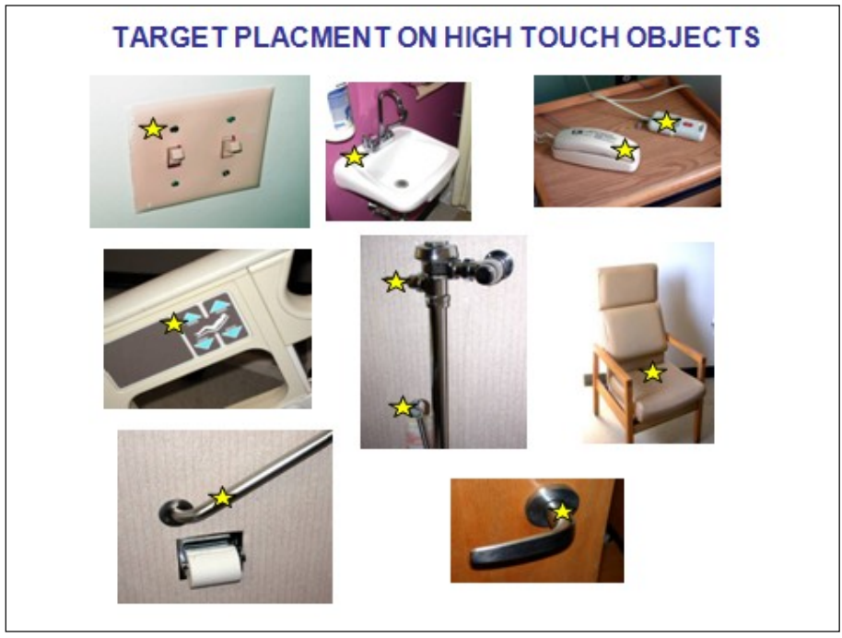
High Touch Object Examples
(CDC, 2010)
Notes:
These are images of high touch surfaces.
Centers for Disease Control and Prevention (CDC). (December 2010). Options for Evaluating Environmental Cleaning. Environmental Evaluation Working Group (cdc.gov)

Slide 22
Types of Disinfectants
Chemical Disinfectants
  Alcohol
  Chlorine and chlorine compounds
  Hydrogen peroxide
  Idophors
  Quaternary ammonium compounds
  Miscellaneous Inactivating Agents
    Other germicides
    Metals as microbicides
    Ultraviolet radiation
    Pasteurization
    Flushing-and washer-disinfectors
(CDC, 2016)
Notes:
There are many types of disinfectants. These are a few of the common types you might see in your facilities. For specific needs, you can refer to the List N and List Q from the EPA to search what disinfectant is needed to kill a particular pathogen. List N is related to COVID-19, while List Q is for emerging viral pathogens.

Slide 23
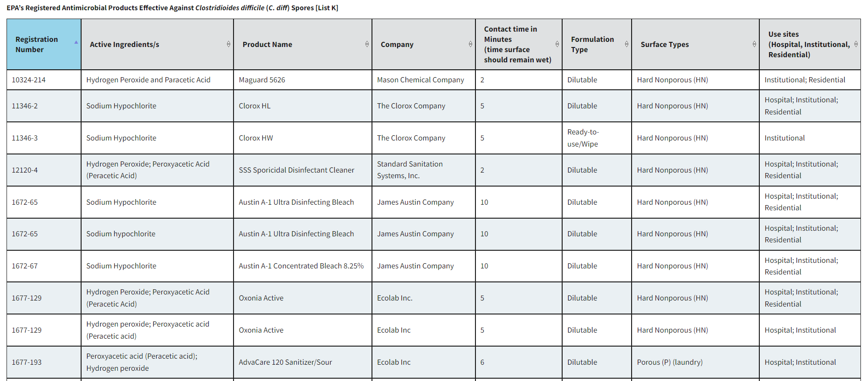
EPA’s List K
(EPA, 2024)
Notes:
This is a glance at the EPA list for registered antimicrobial products that effectively kill c.diff spores. This is list K. This is a great example of the registration number, the active ingredients, the name, contact time, the surface type and sites where they can be used.
Environmental Protection Agency (2024). EPA’s Registered Antimicrobial Products Effective Against Clostridioides difficile (c.diff) Spores [List K]. EPA. EPA’s Registered Antimicrobial Products Effective Against Clostridioides difficile (C. diff) Spores [List K] | US EPA

Slide 24
Factors affecting activity of antimicrobials
Number and type of microorganism
Type and concentration of the antimicrobial
pH of solution
Formulation
Length of exposure
Temperature
Types of surface and pre-cleaning process
(Artasensi, Mazzotta, Fumagalli, 2021)
Notes:
When choosing and using a disinfectants, it is important to know the factors that affect the activity:
Number and type of microorganism
Type and concentration of the antimicrobial
pH of solution
Formulation
Length of exposure
Temperature
Types of surface and pre-cleaning process
Artasensi, A., Mazzotta, S., & Fumagalli, L. (2021). Back to Basics: Choosing the Appropriate Surface Disinfectant. Antibiotics (Basel, Switzerland), 10(6), 613. https://doi.org/10.3390/antibiotics10060613
Back to Basics: Choosing the Appropriate Surface Disinfectant - PMC (nih.gov)

Slide 25
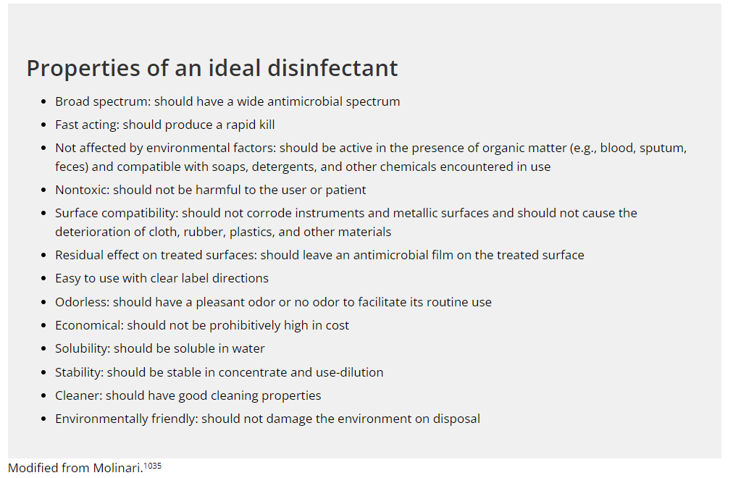
Selecting an agent
(CDC, 2016)
Notes:
When selecting a disinfectant know that:
It must Must be EPA-registered
They are typically not interchangeable
Depends on performance characteristics and item/surface being cleaned
Here are some properties of an ideal disinfectant
(see list above)
Table 2 | Disinfection & Sterilization Guidelines | Guidelines Library | Infection Control | CDC
Centers for Disease Control and Prevention (CDC). (September 18, 2016). Guideline for Disinfection and Sterilization in Healthcare Facilities. Table 2 | Disinfection & Sterilization Guidelines | Guidelines Library | Infection Control | CDC

Slide 26
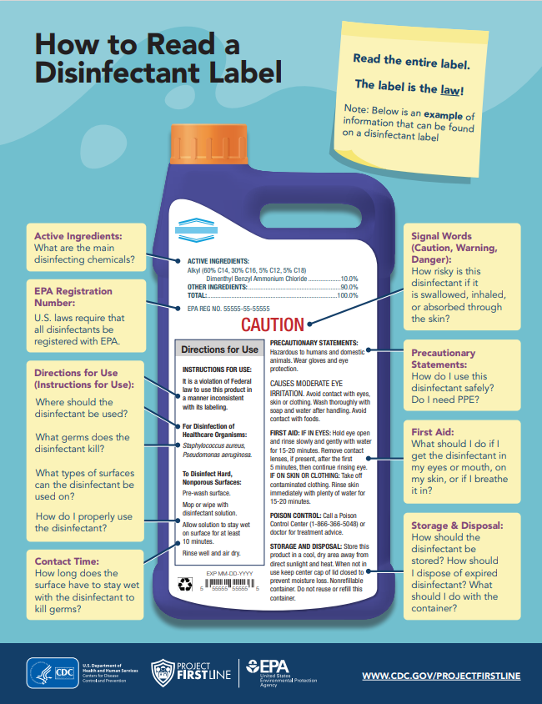
Read the label
(CDC, 2023c)
Notes:
Follow manufacturer’s instructions for use
Contact time-how long must the surface remain wet to kill the pathogens
Importance of dwell time, surface needs to be wet (not just wiped) –dwell time might change for example c.diff (this one is 10 minutes) do you have 10 minutes to wait
How do you safely use and dispose of the wipes.
Kill claim
This infograph is a great resource from project firstline on how to read a disinfectant label. As you can see, the label will tell you the active ingredients, the EPA registration number, the directions for use, contact time, signal words like caution and waring, precautionary statements, first aid, and storage and disposal.
Centers for Disease Control and Prevention (CDC). (October 30, 2023). How to Read a Disinfectant Label. Project Firstline. How to Read a Disinfectant Label (cdc.gov)

Slide 27
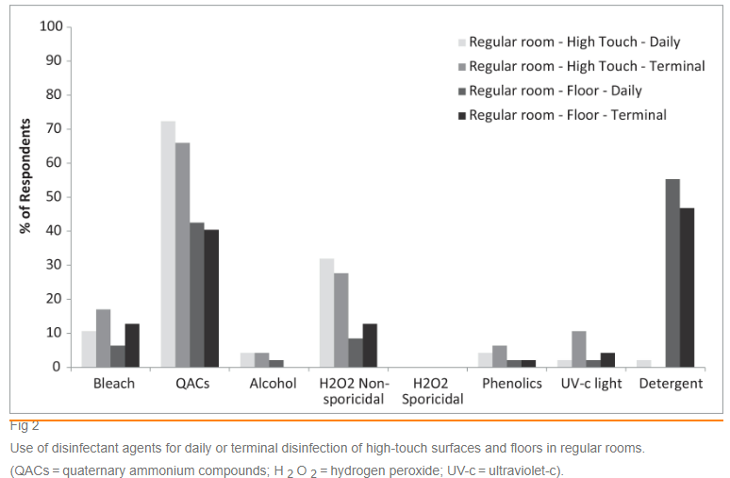
Survey on High Touch Areas vs Floors
(Han et al., 2021)
Notes:
These survey results were discussed and published in JAIC in 2021. 47 evs workers form 26 states surveyed on their environmental disinfection practices from January to june 2019. The survey found consistencies amongst most in their use of bleach and quaternary ammonium, additionally 81% clean high touch areas in contact rooms with bleach. Several variations in practices were also found.
UV-C (importance of cleaning before use)
Han, Z., Pappas, E., Simmons, A., Fox, J., Donskey, C. J., & Deshpande, A. (2021). Environmental cleaning and disinfection of hospital rooms: A nationwide survey. American Journal of Infection Control, 49(1), 34–39. https://doi.org/10.1016/j.ajic.2020.08.008
Environmental cleaning and disinfection of hospita...: Full Text Finder Results (ebscohost.com)
Variations in high touch surfaces vs floor

Slide 28
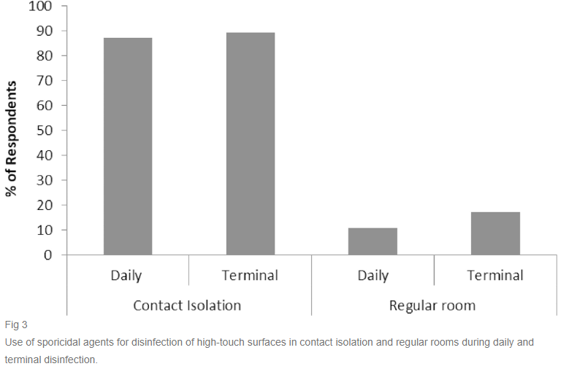
Daily vs Terminal Clean Selection
(Han et al., 2021)
Notes:
This shows the use of sporicidal agents in contact verses regular rooms. Think about the significance of c.diff carriers and needing sporicidal. I think this survey, while small, underscores the importance of standardized procedures.
Han, Z., Pappas, E., Simmons, A., Fox, J., Donskey, C. J., & Deshpande, A. (2021). Environmental cleaning and disinfection of hospital rooms: A nationwide survey. American Journal of Infection Control, 49(1), 34–39. https://doi.org/10.1016/j.ajic.2020.08.008
Environmental cleaning and disinfection of hospita...: Full Text Finder Results (ebscohost.com)

Slide 29
General Technique
Facility specific policies and procedures should be created for cleaning and disinfecting
Process should minimize cross-contamination
Move from least soiled to most soiled area
Clean from high to low
Move systematically
Pick a starting point (ex: door) and move either clockwise or counterclockwise in the room
Dusting
  Dust contains fungal spores
  Top to bottom
  Allow dust to fall to floor before mopping
  Use a chemically treated microfiber cloth or dust mop
(Chou, 2014)
Notes:
What is the recommended technique for cleaning and disinfecting. The general technique includes:
Facility specific policies and procedures should be created for cleaning and disinfecting
Process should minimize cross-contamination
Move from least soiled to most soiled area
Clean from high to low
Move systematically
Pick a starting point (ex: door) and move either clockwise or counterclockwise in the room
Dusting-Don’t dust in an occupied room
Dust contains fungal spores
Top to bottom
Allow dust to fall to floor before mopping
Use a chemically treated microfiber cloth or dust mop
Chou, T. (October 2, 2014). Environmental Services. APIC Text. 109. Environmental Services | Infection Prevention for Support Services and the Care Environment | Table of Contents | APIC
109. Environmental Services | Infection Prevention for Support Services and the Care Environment | Table of Contents | APIC

Slide 30
Around the room
Walls, windows and doors
  Clean microfiber mop for walls
Horizontal surfaces
  Wipes at regular frequency
  When visibly soiled, use EPA-registered disinfectant
Mattresses and pillows
  Moisture resistant, easy to clean
  Discard if cracks, tears or permanent stains
(Chou, 2014)
Notes:
What about the items around the room?
Walls, windows and doors
Clean microfiber mop for walls
Horizontal surfaces
Wipes at regular frequency
When visibly soiled, use EPA-registered disinfectant
Mattresses and pillows
Moisture resistant, easy to clean
Discard if cracks, tears or permanent stains
Chou, T. (October 2, 2014). Environmental Services. APIC Text. 109. Environmental Services | Infection Prevention for Support Services and the Care Environment | Table of Contents | APIC
109. Environmental Services | Infection Prevention for Support Services and the Care Environment | Table of Contents | APIC

Slide 31
Around the room
Privacy curtains
  High touch item
  If in isolation, change and cleaned routinely and when soiled
  If contact isolation, removed and laundered after discharge
  Specific regulations for laundering
Window treatments
  Should be washable or able to be cleaned
  Cleaned on a regular schedule and when soiled/contaminated
(Chou, 2014)
Notes:
Privacy curtains
High touch item
If in isolation, change and cleaned routinely and when soiled
If contact isolation, removed and laundered after discharge
Specific regulations for laundering
Window treatments
Should be washable or able to be cleaned
Cleaned on a regular schedule and when soiled/contaminated
Chou, T. (October 2, 2014). Environmental Services. APIC Text. 109. Environmental Services | Infection Prevention for Support Services and the Care Environment | Table of Contents | APIC
Discrepancies on frequency of changing when in iso CDC vs AHE
109. Environmental Services | Infection Prevention for Support Services and the Care Environment | Table of Contents | APIC

Slide 32
Bathrooms
Special attention to high touch areas
Check for mold in grout
Remove mold appropriately with approved solution and friction
Inspect counters for cracks and mold which would indicated replacement is needed
Decontaminate in room and remove bedside commode as soon as no longer needed
(Chou, 2014)
Notes:
Bathrooms:
Special attention to high touch areas
Check for mold in grout
Remove mold appropriately with approved solution and friction
Inspect counters for cracks and mold which would indicated replacement is needed
Decontaminate in room and remove bedside commode as soon as no longer needed
Chou, T. (October 2, 2014). Environmental Services. APIC Text. 109. Environmental Services | Infection Prevention for Support Services and the Care Environment | Table of Contents | APIC
109. Environmental Services | Infection Prevention for Support Services and the Care Environment | Table of Contents | APIC

Slide 33
Frequency of cleaning and disinfecting
Walls, window and doors-regular schedule
  High touch items daily
Horizontal surfaces-at least daily
Mattresses and pillows-between patient use and when soiled
Privacy curtains-regular schedule if no isolation
Window treatments-regular schedule
Bathrooms-at least daily
  If diarrhea or c. difficile increase to three times a day
(Chou, 2014)
Notes:
Walls, window and doors-regular schedule
High touch items daily
Horizontal surfaces-at least daily
Mattresses and pillows-between patient use and when soiled
Privacy curtains-regular schedule if no isolation
Window treatments-regular schedule
Bathrooms-at least daily
If diarrhea or c. difficile increase to three times a day
More frequent cleanings if an outbreak is occurring
Diarrhea and horizontal surfaces-increase high touch to three cleanings and low touch to two cleanings
Chou, T. (October 2, 2014). Environmental Services. APIC Text. 109. Environmental Services | Infection Prevention for Support Services and the Care Environment | Table of Contents | APIC

Slide 34
Monitoring and Evaluation
Processes and programs to optimize thoroughness of cleaning
Implement objective monitoring programs
Level 1 Program
  More basic
  Joint IPC/ES effort
  Hospital specific, but consistent with CDC standards
  Measures for monitoring
  Interventions to optimize practices
  Report to ICC and leadership
Level 2 Program
  Similar to level 1
  Objective monitoring assessment with pre-intervention TDC score
  Structure education
  Ongoing, scheduled monitoring at least 3 times per year
  Ongoing education and feedback
  Standing agenda item
  Could report to state via NHSN checklist
(CDC, 2010)
Notes:
How to monitor and evaluate. The CDC is has great tools for evaluating environmental cleaning and disinfection. These are a couple of options they recommend, but First, you should have
Processes and programs to optimize thoroughness of cleaning
Implement objective monitoring programs
Level 1 Program
More basic
Joint IPC/ES (infection prevention and control and Environmental services) effort
Hospital specific, but consistent with CDC standards
Measures for monitoring
Interventions to optimize practices
Report to Infection Control Committee (ICC) and leadership
Level 2 Program
Similar to level 1
Objective monitoring assessment with pre-intervention TDC (thoroughness of disinfection cleaning) score
Structure education
Ongoing, scheduled monitoring at least 3 times per year
Ongoing education and feedback
Standing agenda item
Could report to state via NHSN (national healthcare safety network) checklist
Centers for Disease Control and Prevention (CDC). (December 2010). Options for Evaluating Environmental Cleaning. Environmental Evaluation Working Group (cdc.gov)
Environmental Evaluation Working Group (cdc.gov)

Slide 35
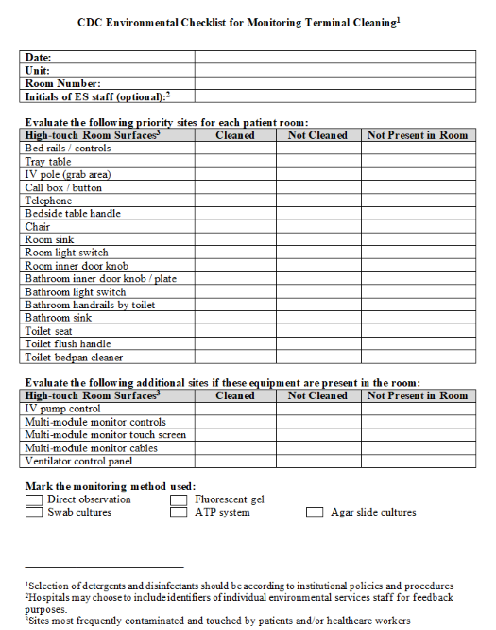
Monitoring Cleaning and Disinfection Processes
(CDC, 2010)
Notes:
This is a nice checklist for monitoring terminal cleaning from the CDC. You can mark what was cleaned vs not cleaned, and the method used for monitoring.
Centers for Disease Control and Prevention (CDC). (December 2010). Options for Evaluating Environmental Cleaning. Environmental Evaluation Working Group (cdc.gov)
Environmental Evaluation Working Group (cdc.gov)

Slide 36
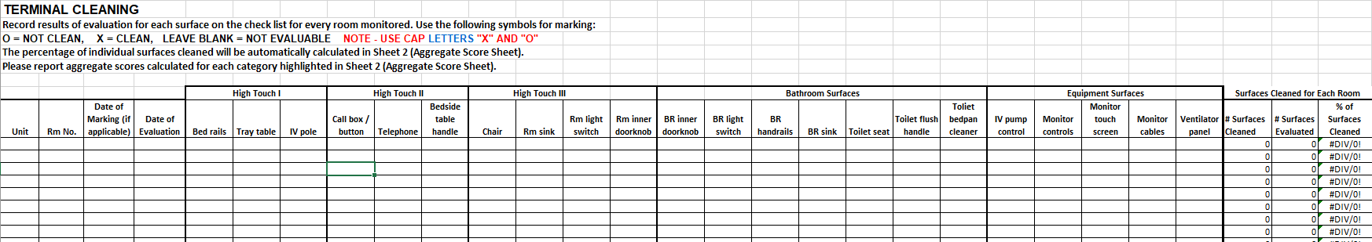
Evaluating Cleaning and Disinfection Processes
Evaluate high touch areas, bathroom surfaces, and other environmental surfaces
Working spreadsheet
Cleaned vs not cleaned (X or O)
% of cleaned surfaces
(CDC, 2010)
Notes:
Additionally the CDC this fantastic working spreadsheet that can be used to evaluate the percentage of surfaces cleaned.
Centers for Disease Control and Prevention (CDC). (December 2010). Options for Evaluating Environmental Cleaning. Environmental Evaluation Working Group (cdc.gov)
Options for Evaluating Environmental Cleaning | HAI | CDC

Slide 37
Methods for evaluating
Direct practice observation
Swab cultures
Agar slide cultures
Fluorescent markers
ATP Biolumuminesence
(CDC, 2010)
Notes:
Here are a few options for evaluating.
Direct practice observation
Swab cultures
Agar slide cultures
Fluorescent markers
ATP Biolumuminesence
Centers for Disease Control and Prevention (CDC). (December 2010). Options for Evaluating Environmental Cleaning. Environmental Evaluation Working Group (cdc.gov)

Slide 38
Objects to evaluate
Bed rails
Tray tables
Call boxes
Telephones
Bedside tables
Patient chairs
IV pole
Sinks
Light switches
Door knobs and handles
Toilet area including handrails
Toilet seats
Toilet handles
Bed pan cleaning equipment
IV pump control panel
Monitor control panel
Monitor touch screen
Monitor cables
Ventilator touch screens
(CDC, 2010)
Notes:
These are the recommended items to evaluate to ensure effective cleaning and disinfection is taking place.
Bed rails
Tray tables
Call boxes
Telephones
Bedside tables
Patient chairs
IV pole
Sinks
Light switches
Door knobs and handles
Toilet area including handrails
Toilet seats
Toilet handles
Bed pan cleaning equipment
IV pump control panel
Monitor control panel
Monitor touch screen
Monitor cables
Ventilator touch screens
Centers for Disease Control and Prevention (CDC). (December 2010). Options for Evaluating Environmental Cleaning. Environmental Evaluation Working Group (cdc.gov)
Environmental Evaluation Working Group (cdc.gov)

Slide 39
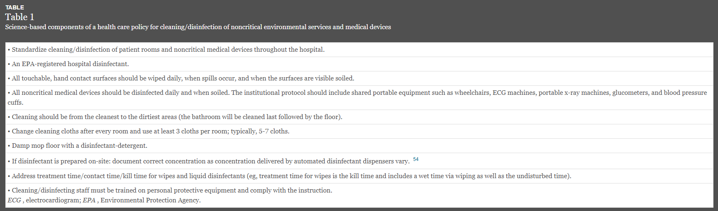
Policy
(Rutala & Weber, 2019)
Notes:
When developing and improving your environmental cleaning and disinfection program, policies and procedures are crucial to the organization or facility’s success. From an article published in 2019 in AJIC, policy and procedure were discussed in additional to a bundle approach for cleaning and disinfection. Here is a list of suggested science-based components of a health care policy for cleaning/disinfection of noncritical environmental services and medical devices.
Available in all languages and developing SWI with pictures
Facility determination of who cleans what? Whose responsibility? (putting a dot on the things they think they are responsibility for cleaning)
Rutala, W. A., & Weber, D. J. (2019). Best practices for disinfection of noncritical environmental surfaces and equipment in health care facilities: A bundle approach. American journal of infection control, 47S, A96–A105. https://doi.org/10.1016/j.ajic.2019.01.014
Best practices for disinfection of noncritical environmental surfaces and equipment in health care facilities: A bundle approach - ClinicalKey

Slide 40
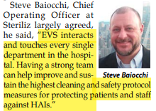
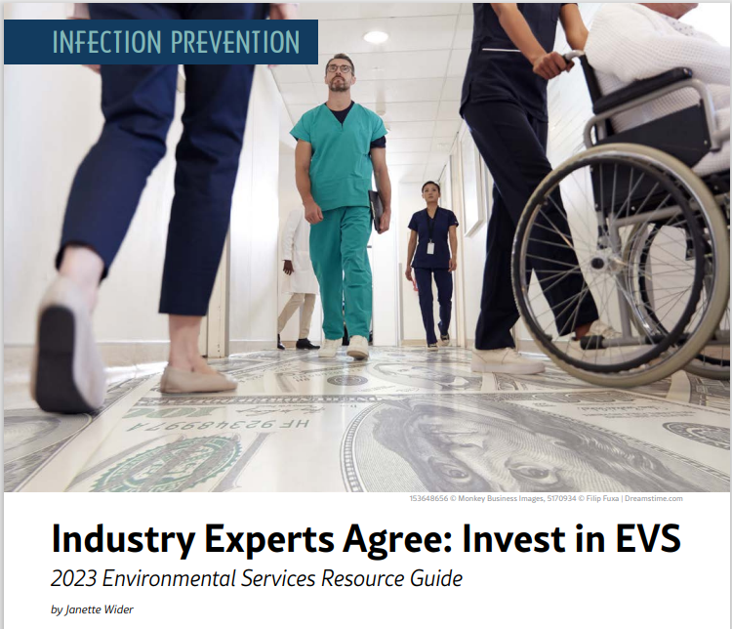
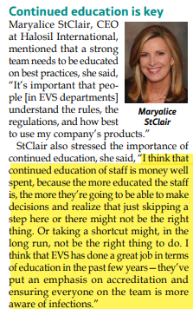
Trainings and education
Certified Healthcare Environmental Services Technician (CHEST) Training
(Hewage et al., 2021; Wilder, 2023)
Notes:
Education and training improves environmental disinfection
Certified Healthcare Environmental Services Technician (CHEST) Training
In a 2023 article of Healthcare Purchasing News, Janette Wider stresses the importance of a strong EVS department.
Hewage, S. C. N., Cao, L. T. T., Jones, R. M., & Fraser, A. M. (2021). Factors associated with environmental service worker cleaning practices in health care settings: A systematic review of the literature. American journal of infection control, 49(7), 919–927. https://doi.org/10.1016/j.ajic.2021.01.001
Wider, J. (2023). Industry Experts Agree: Invest in EVS: 2023 Environmental Services Resource Guide. Healthcare Purchasing News, 47(7), 20–22.
Factors associated with environmental service worker cleaning practices in health care settings: A systematic review of the literature (clinicalkey.com)

Slide 41
References
Artasensi, A., Mazzotta, S., & Fumagalli, L. (2021). Back to Basics: Choosing the Appropriate Surface Disinfectant. Antibiotics (Basel, Switzerland), 10(6), 613. https://doi.org/10.3390/antibiotics10060613
Centers for Disease Control and Prevention (CDC). (May 4, 2023a). Examples of high-touch surfaces in a specialized patient area. Appendix C: Examples of High-Touch Surfaces | Environmental Cleaning in Global Healthcare Settings | HAI | CDC
Centers for Disease Control and Prevention (CDC). (July 28, 2023b). HAI Pathogens and Antimicrobial Resistance Report, 2018-2021. HAI Pathogens and Antimicrobial Resistance Report, 2018-2021 | NHSN | CDC
Centers for Disease Control and Prevention (CDC). (October 30, 2023c). How to Read a Disinfectant Label. Project Firstline. How to Read a Disinfectant Label (cdc.gov)
Centers for Disease Control and Prevention (CDC). (November, 20, 2023d). Session 2: Environmental Reservoirs (Slide Set). https://www.cdc.gov/infectioncontrol/ppt/Healthcare-Training-ReservoirsTK-S2-Slides-508.pptx
Centers for Disease Control and Prevention (CDC). (April 28, 2022a). Chain of Infection Components. NIOSH. Chain of Infection Components (cdc.gov)

Slide 42
References
Centers for Disease Control and Prevention (CDC). (March 11, 2022b). Germs Live in the Environment. Project Firstline. Germs Live in the Environment | Project Firstline | Infection Control | CDC
Centers for Disease Control and Prevention (CDC). (March 11, 2022c). Learn Where Germs Live in Healthcare. Project Firstline. Learn Where Germs Live in Health Care | Project Firstline | Infection Control | CDC
Centers for Disease Control and Prevention (CDC). (March 24, 2022d). Recognize Infection Risks in Health Care. Project Firstline. Recognize Infection Control Risks in Health Care | Project Firstline | CDC
Centers for Disease Control (CDC). (January 28, 2022e). Cleaning? Disinfection? What is the Difference? cdc.gov/infectioncontrol/projectfirstline/videos/Ep16-CLEANING-LoRes.mp4

Slide 43
References
Center for Disease Control and Prevention (CDC). (October, 13, 2020). Reduce Risk for Surfaces. Reduce Risk from Surfaces | HAI | CDC
Centers for Disease Control and Prevention (CDC). (September 18, 2016). Guideline for Disinfection and Sterilization in Healthcare Facilities. Table 2 | Disinfection & Sterilization Guidelines | Guidelines Library | Infection Control | CDC
Centers for Disease Control and Prevention (CDC). (December 2010). Options for Evaluating Environmental Cleaning. Environmental Evaluation Working Group (cdc.gov)
Chou, T. (October 2, 2014). Environmental Services. APIC Text. 109. Environmental Services | Infection Prevention for Support Services and the Care Environment | Table of Contents | APIC
Environmental Protection Agency (2024). EPA’s Registered Antimicrobial Products Effective Against Clostridioides difficile (c.diff) Spores [List K]. EPA. EPA’s Registered Antimicrobial Products Effective Against Clostridioides difficile (C. diff) Spores [List K] | US EPA
Han, Z., Pappas, E., Simmons, A., Fox, J., Donskey, C. J., & Deshpande, A. (2021). Environmental cleaning and disinfection of hospital rooms: A nationwide survey. American Journal of Infection Control, 49(1), 34–39. https://doi.org/10.1016/j.ajic.2020.08.008

Slide 44
References
Hewage, S. C. N., Cao, L. T. T., Jones, R. M., & Fraser, A. M. (2021). Factors associated with environmental service worker cleaning practices in health care settings: A systematic review of the literature. American journal of infection control, 49(7), 919–927. https://doi.org/10.1016/j.ajic.2021.01.001
Huang, J., Cui, C., Zhou, S., Chen, M., Wu, H., Jin, R., & Chen, X. (2020). Impact of multicenter unified enhanced environmental cleaning and disinfection measures on nosocomial infections among patients in intensive care units. The Journal of international medical research, 48(8), 300060520949766. https://doi.org/10.1177/0300060520949766
Kramer, A., & Assadian, O. (2014). Survival of Microorganisms on Inanimate Surfaces. Use of Biocidal Surfaces for Reduction of Healthcare Acquired Infections, 7–26. https://doi.org/10.1007/978-3-319-08057-4_2
Lei, H., Xiao, S., Cowling, B. J., & Li, Y. (2020). Hand hygiene and surface cleaning should be paired for prevention of fomite transmission. Indoor Air, 30(1), 49–59. https://doi.org/10.1111/ina.12606
Parry, M. F., Sestovic, M., Renz, C., Pangan, A., Grant, B., & Shah, A. K. (2022). Environmental cleaning and disinfection: Sustaining changed practice and improving quality in the community hospital. Antimicrobial stewardship & healthcare epidemiology : ASHE, 2(1), e113. https://doi.org/10.1017/ash.2022.257

Slide 45
References
Rutala, W. A., & Weber, D. J. (2019). Best practices for disinfection of noncritical environmental surfaces and equipment in health care facilities: A bundle approach. American journal of infection control, 47S, A96–A105. https://doi.org/10.1016/j.ajic.2019.01.014
Stephens, B., Azimi, P., Thoemmes, M. S., Heidarinejad, M., Allen, J. G., & Gilbert, J. A. (2019). Microbial Exchange via Fomites and Implications for Human Health. Current pollution reports, 5(4), 198–213. https://doi.org/10.1007/s40726-019-00123-6
Watson, P. A., Watson, L. R., & Torress-Cook, A. (2016). Efficacy of a hospital-wide environmental cleaning protocol on hospital-acquired methicillin-resistant Staphylococcus aureus rates. Journal of infection prevention, 17(4), 171–176. https://doi.org/10.1177/1757177416645342
Weber, David J.a,b; Anderson, Deverickc; Rutala, William A.a,b. The role of the surface environment in healthcare-associated infections. Current Opinion in Infectious Diseases 26(4):p 338-344, August 2013. | DOI: 10.1097/QCO.0b013e3283630f04
Wider, J. (2023). Industry Experts Agree: Invest in EVS: 2023 Environmental Services Resource Guide. Healthcare Purchasing News, 47(7), 20–22.

Slide 46

Follow Us On Social

Slide 47

KentuckyIPTraining.org

